Slide 1
Session 22
Introduction to Section 4
Digital Inequality – Nationally
Digital Inequality – Globally

Slide 2
Preview of Section 4
SECTION 4: Inequality, Scarcity, Poverty, Ethics, Culture
Scarcity and Poverty: not just less of the same, but distinctive practices | The repair and maintenance of computing technologies in Namibia and Ghana.
Ethics | Online labor and the ‘Turkers’ of Amazon Mechanical Turk
What is culture? How might technology designs embody and reflect the cultures they are developed within? How forms of use reflect the cultural context of user populations? | Nissenbaum – Values in Design (as an approach) The appropriation of cell phones in Jamaica (domestication of tech)
Intercultural communication: encounters through & cross-cultural design | How do Indian call center workers come to understand Americans and American culture through phone conversations?

Slide 3
Digital inequalitY vs. The Digital Divide
A National View

Slide 4
Inequality and Digital Tech: what is the relationship?
The uneven diffusion of digital technologies may “exacerbate existing inequalities by increasing the opportunities already available to the already privileged while leading to the growing marginalization of the disadvantaged” – Hargittai (1st reading)
Often measured through comparisons broken down by gender, ethnicities, geographic location (rural/urban), class, education level, and/or income.

Slide 5
Why does being ‘connected’ matter?
In what ways has your own Internet savvy benefitted you in practical ways?
Hargittai:
Internet skills as part of job requirement, factors into productivity
To gain skills - enrichment or to become more employable (Python online courses?)
Save money
Expand social network, social support
Political engagement

Slide 6
The Digital Divide
Access (as a binary - ‘haves’ and ‘have nots’)
Quality of access
Skills
Relevance
Support (for repairs, extending skills)

Slide 7
The State of the Digital Divide (USA)
The Domestic Digital Divide (USA) 2010
Notes:
From 2010, source:
http://media.nj.com/njv_kelly_heyboer/other/internetgraphic.pdf
Predictably differences based on income (the Internet costs money)
Left out gender from this graph because it was an even split – 74%
Another thing to point out no very substantial urban / rural divide.

Slide 8
Gender
As of 2010:
74% of men have Internet access.
74% of women have Internet access.
Can we say then that the gap has been closed?
Notes:
What would your readings suggest?

Slide 9
Moving Beyond the Digital Divide
Argument #1: … because it no longer exists?
Evidence: plateauing Internet penetration and a narrowing gap (see Pew Internet & American Life stats)
What is the response from Robinson (2nd reading) on economically disadvantaged youth in the agricultural belt in CA?

Slide 10
Moving Beyond the Digital Divide
Argument #2: … because it doesn’t address consequential differences within the connected population
Hargittai – differentiated uses (some use the Internet superficially – TV schedules?)
Robinson – but use orientations stem from quality of access – “a taste for the necessary”
Notes:
Not enough to be someone who

Slide 11
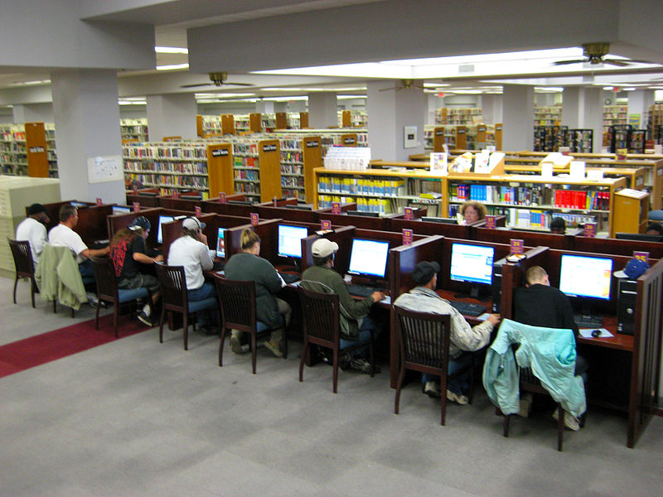
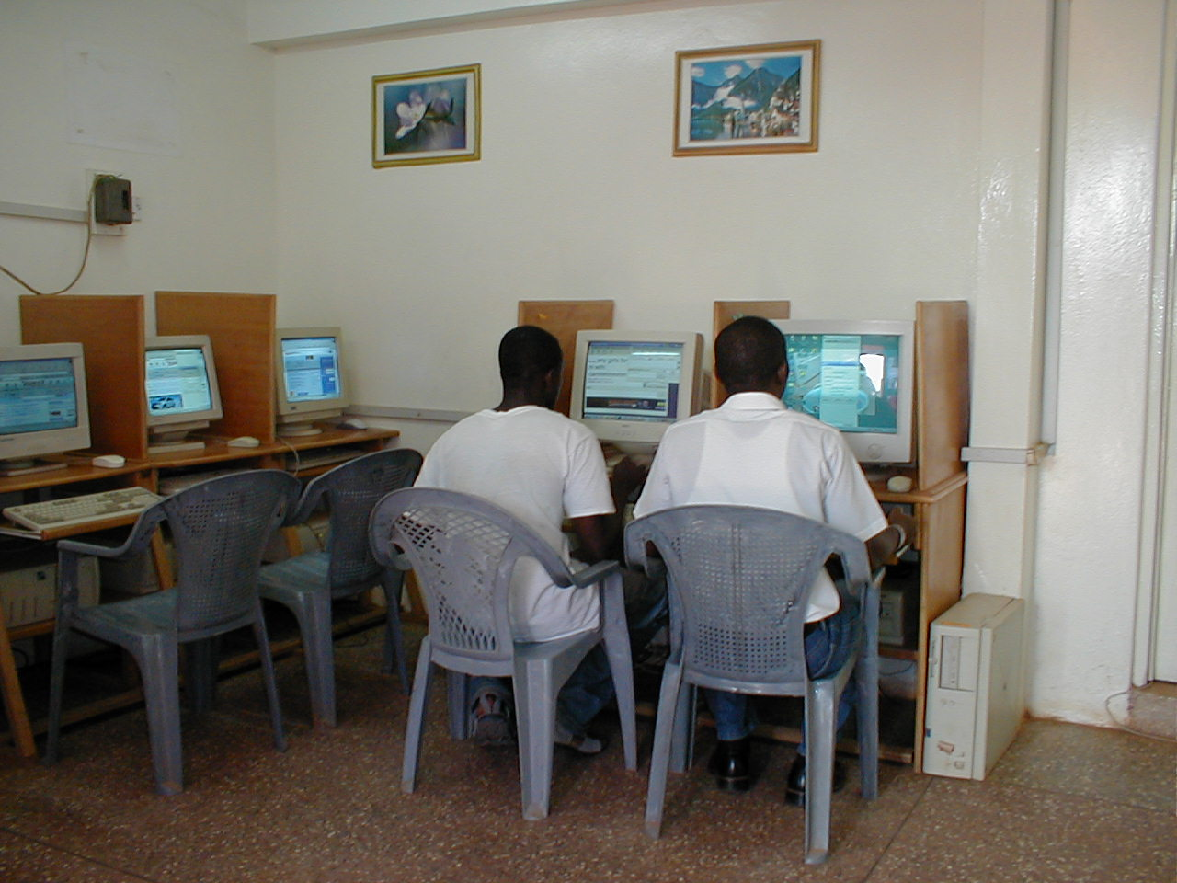
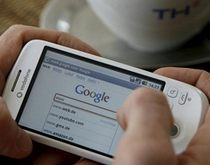

Slide 12
Moving Beyond the Digital Divide
Argument #3: … doesn’t differentiate among non-user population and elective non-use.
Internet use has plateaued.
See Lenhart and Horrigan (2003) on “Re-visualizing the digital divide as a digital spectrum”

Slide 13
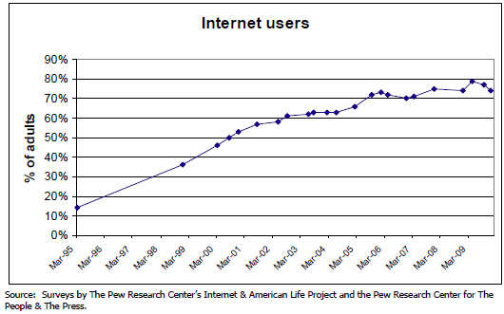

Slide 14
From Divide to Spectrum (2003)
Notes:
Pointing to some shortcomings of the binary. – labelling all these different groups “suggest that the idea of a digital divide, defined by the simple idea of people being either online or offline, is a less accurate way of understanding adoption of the Internet than the idea of a spectrum of access. There is unevenness in people use and non-use of the Internet.”
A spectrum – not a range from low to high.
But clusters – different broad types of user and non-user that can be labeled and named - “to provide policy makers, researchers, governments and non-profit agencies…with more specific information about the differing outlooks on the Internet, social contexts and demographics among subgroups.”
Useful to see this in color (the reader printed it in black and white).
A spectrum: “A band of colors, as seen in a rainbow, produced by separation of the components of light by their different degrees of refraction according to wavelength.” Groups with qualitatively different experiences.
What I like about this article is that in addition to offering these descriptive categories and the percentages and also some insights into what circumstances sort people into these groups. What perspectives they bring to the technology. Challenges some notion of the Internet as immediately and obviously useful to anyone who adopts it, no going back (in fact there is ‘going back’)
Users (of broadband 13% and dial-up 20-30%) -- now up to 60% (as of 2010)
Intermittent users (16-28%) – those who have gone offline for extended periods – fed up or cut off – don’t have time (most common), tech and ISP problems, after that didn’t like or need it, can’t get it (moved away), to hard, fear of crime and children’s safety, spam and porn. More likely to be newer users.
Net dropouts (10%) – once had access but no longer. Tend to be younger and low-income. Can get to Internet (public library) but don’t, aren’t interested.
Net evaders – live with someone who uses the Internet, but they don’t. Have the same demographic profile of Internet users. Talked about fears – of addiction, being able to gain skill. Using Internet as a kind of weakness, pleased to not “need” it. Access issues – a household member who monopolizes the computer is at play here?
Truly unconnected – haven’t ever gone online. New few or no people who go online (so no support structure to help them navigate). Believe they would not benefit and are worried about objectionable content, and fraud. Consider Internet dangerous. Or mostly just for entertainment.

Slide 15
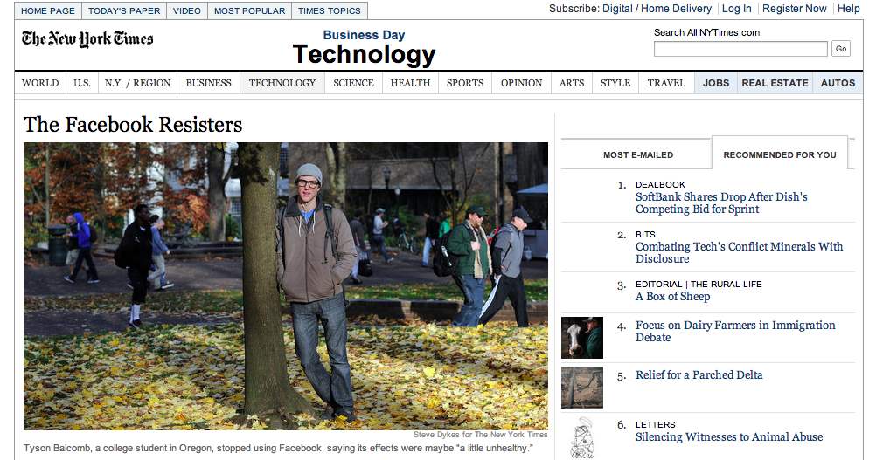

Slide 16
Consider….
A Medicare system overhaul (gov program for people age 65+) forces all recipient to make some important decisions…a website (only) is provided to disseminate information and the new system
In Ghana, the process for scheduling travel visa interviews at the US embassy becomes online-only in 2004.
A petitioner seeks signatures to support a measure to extend online voting as an option for California voters as a way to extend voting access.
Notes:
How might our readings relate to these scenarios

