Slide 1
Assignment 2 Preparation
Flickr mini-assignment #2 (due Thursday Mar. 6) – take a photo of your own (individual or collaborative) work environment and post to the Flickr pool
Diary Exercise – log your own paper vs digital tech use (for at least 1-2 days). You will reference your own diary in assignment 2, but it does not need to be turned in.

Slide 2
Flickr Mini-Assignment #2 (due Thu Mar 6)
How Exactly Do We Work? Pay some careful attention to your own work practices
Photograph a permanent or temporary workspace you use either alone or with a group. The image should be captured mid-activity (not when everything is cleaned up and put away).
In the caption section describe the activity underway and explain the tools that are being used in this photo and how they are being used. In particular refer to any paper as well as screen-based technologies and any other tools and how they are supporting the activity depicted in the image.
Further details posted on the course website

Slide 3
Example structure for a diary of work practices (can be free-form like this or more structured, keep a diary for 1 or 2 working days, not turned in)

Slide 4
Assignment 2 (due Thu Mar 14th)
Deadline extended from Tuesday Mar 12th to Thursday Mar 14th!
Will be posted by the end of the day today on the course website. Same general format as assignment 1.
Change to +/- 50 words above or below the stated word count limit this time.
Will discuss the assignment further on Thursday

Slide 5
Session 13
Paper in Work Practices (beyond the artifact-centric view)
Considering the diversity of work roles within and across organizations
Design Approaches: what to do about paper?

Slide 7
Critique of the Concept of “Affordances”
Useful to think in this way, to compare, gain clarity on the possibilities of paperlessness (i.e. under what circumstances digital devices might supplant paper, what barriers remain to that outcome)
Limits of this approach:
…context and specific work practices ignored in favor of thinking about fixed properties of tools/technologies
comparison suggests a choice must be made, but we work (to this day) through a combination of paper and digital devices

Slide 8
Small Group Task: the state of books
Discuss:
Have you read an entire book on a digital device?
Are most of the books you now read in paper form or on a digital device?
What was the first book you read entirely on a digital device and, if you can recall, what new circumstances made that possible, desirable?
If you still use both formats, how do you decide which books to read on a digital device vs. on paper?
Notes:
Thinking about context. One rule for reading books? Or does it depend on the book, the type of reading demanded of a particular activity.

Slide 9
Paper in work practices
Cognition vs. collaboration, diverse work roles

Slide 10
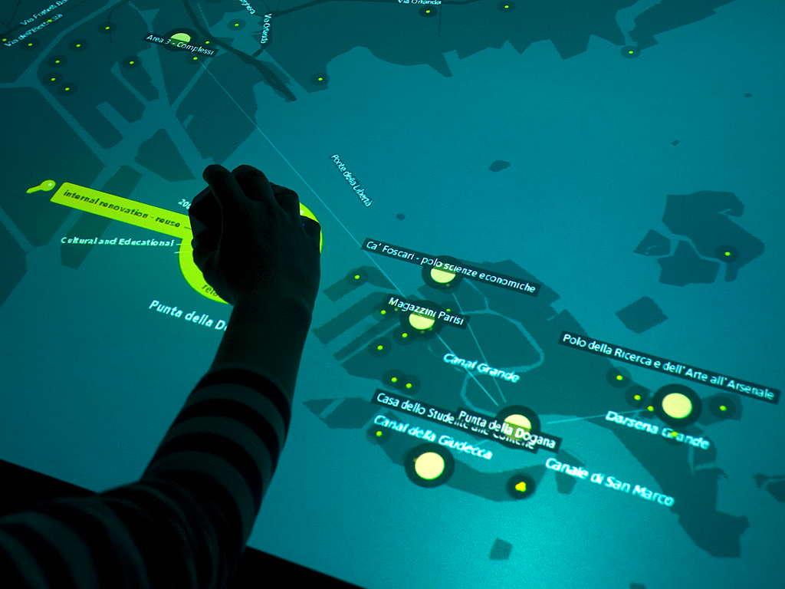
Work Practices: A Primary Distinction
Cognitive work
Organizing, comparing through spatial arrangement (spreading papers across desk)
Visibility of “clutter” as a reminder of ideas
Collaborative work
Paper supports “social mechanisms” – visibility of engagements with the text in question
Notes:
Within a given job can draw a primary distinction (as they do in the book) between the way we engage with tools and resources in our own individual work vs. while working with co-present others. In the book seem to mean in-person collaboration – though now we might talk about synchronous collaboration online – Google doc work, WebEx presentations to distributed groups.
Cognitive work – lab studies in the chapter on “reading from paper” (though kind of weird – not really a standard experimental design) get even deeper into this. Spatial arrangements, but also our spatial memory within a book or document about where something is located. The use of tangible cues – two handed, use of fingers to hold place, observation of movement that expert work of anticipating a next move (page turn). Doing things concurrently rather than serially.
MotPO points to an even heavier reliance on paper in in-person collaborative work … why is that? Shared visibility…the problematic barrier of two people separated by a laptop screen where only one knows what is going on on the screen – support or distraction, not shared.
These images illustrate some design approaches mean to address specifically some of the cognitive challenges – especially around spatial displays. Table top, tangible user interfaces. The display from Minority Report (based on Media Lab research)

Slide 11
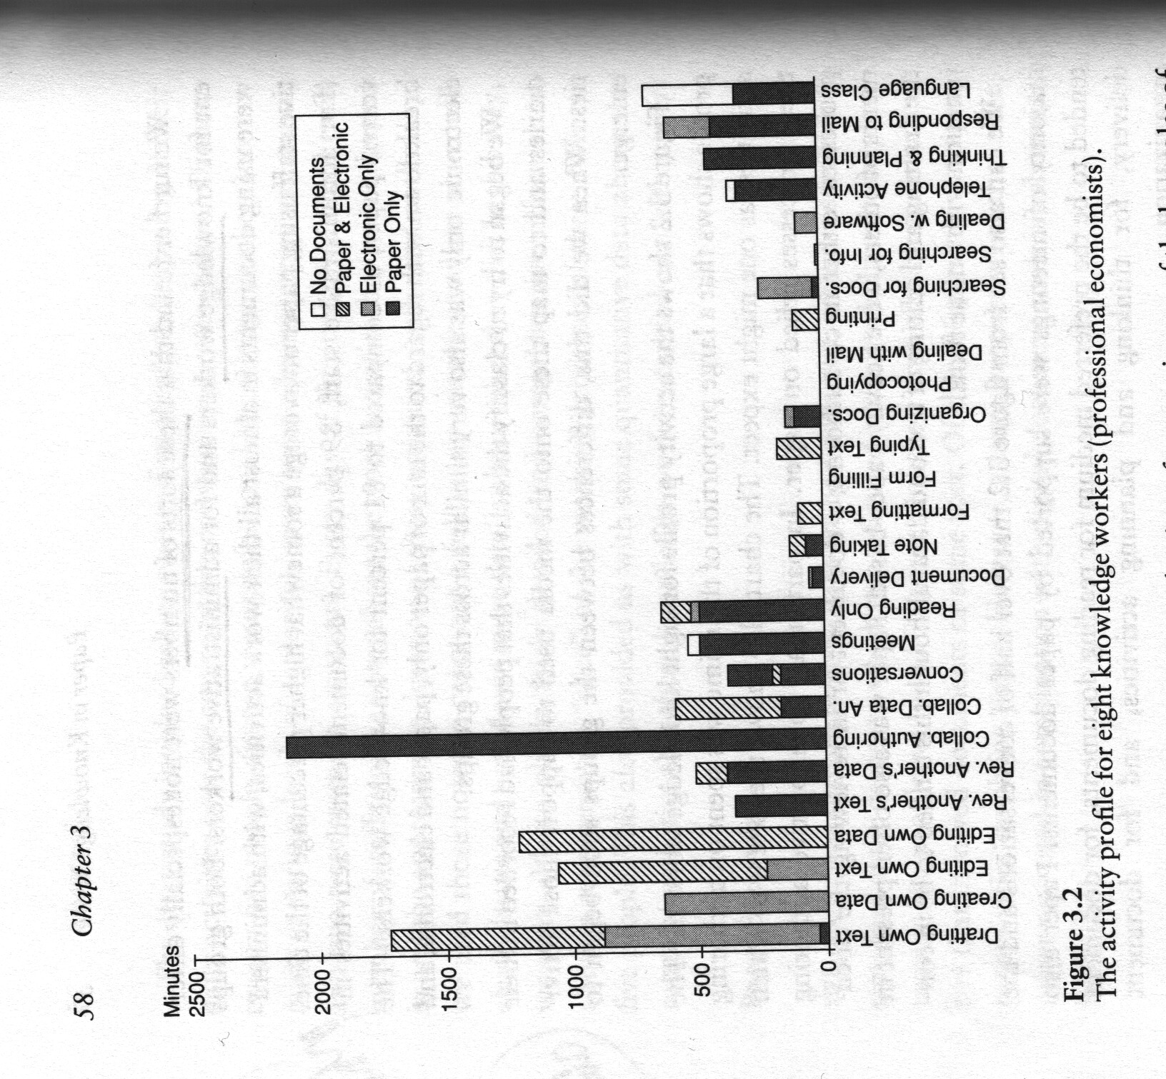
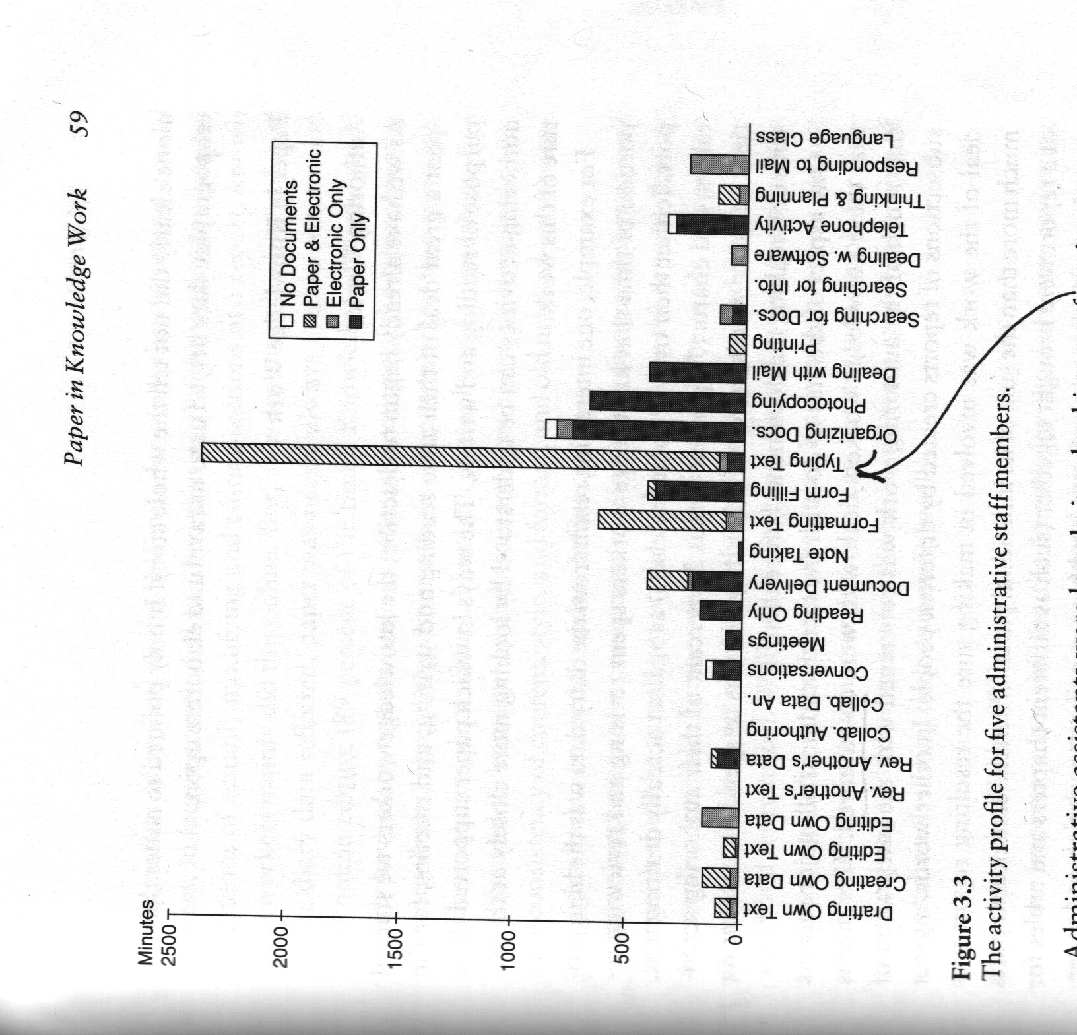
Differing Work Roles Within Organizations
Knowledge workers at the IMF
IMF administrators
Notes:
Rewinding back to one of the earlier chapters. Wanted to highlight this which I think draws a nice sharp distinction, nicely concrete and specific, readily comparable.
To make the point that different roles engage in different activities, spend their time very differently – one might expect quite different demands from devices as far as affordances. Not one size fits all – not one complete solution to all office work.
Within an organization very different emphasis in the kind of work individuals do…the big difference between what they refer to in the book as “knowledge workers” and administrative workers. The former doing a great deal of “collaborative authoring” whereas the latter do lots of “typing text.”

Slide 12
Work Roles Across Different Kinds of Organizations
Work Role | Proposed Project | Role Related Issues
Air Traffic Controllers | Digitizing flight progress strips
Police Work | Given laptops to enter police reports
Office Workers at a Chocolate Manufacturer | Document management system for sharing files
Notes:
Not just within organizations – but between organizations of course we can expect work roles to vary:
Air traffic controllers, management and senior controllers delegate work – need to see visually how much a junior controller has on their plate to make sure they are not overloaded (a life or death matter). What possible solution to digitize flight progress strips – make organizational changes (to be more like the US ATC)?
Police work – problem of digitizing incomplete reports. Result is double data entry – paper report then typed.
Chocolate manufacturers – only 7% of papers were deemed suitable for scanning into the DMS…the other were personal, part of work in progress (uncompleted)

Slide 13
Work Roles Across Different Kinds of Organizations
Work Role | Proposed Project | Role Related Issues
Air Traffic Controllers | Digitizing flight progress strips | Shared visibility, workload management
Police Work | Given laptops to enter police reports | social work (interacting with crime victims), evolving nature of police reports
Office Workers at a Chocolate Manufacturer | Document management system for sharing files | Intelligibility of shared documents, rituals of paper transfer to delegate responsibility, paper as physical reminder

Slide 14
Design Approaches
MotPO – Chapter 6

Slide 15
Two Approaches
Studying how paper (and other tools) are used:
To inform design improvements in tools that seek to replace some aspect of paper use
“accept the usefulness of paper as one kind of technology and attempt to develop ways of integrating that technology with another, namely, electronic” - pg. 182
Notes:
Two ways (as they suggest) that we might start to think about design making use of these insights.

Slide 16
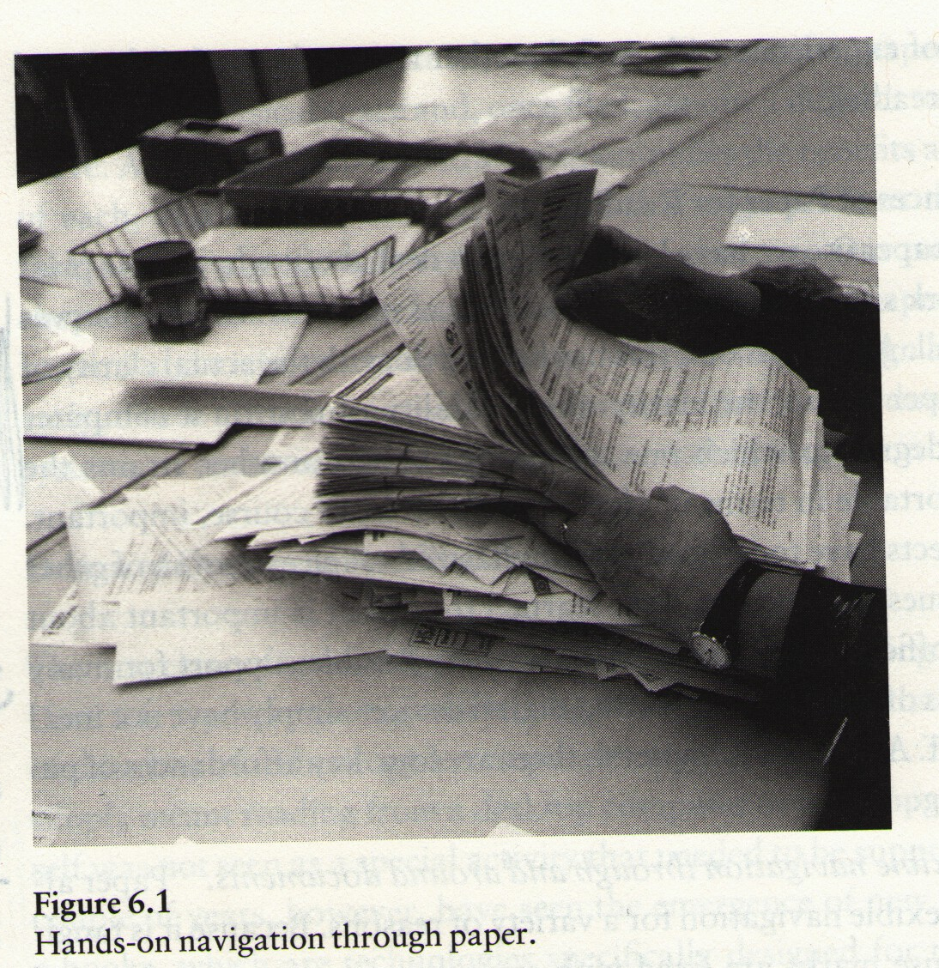
Myth of the Paperless Office Design Recommendations
Multi-modality (adding tactile and audio to visual cues)
Direct interfaces (touch screen rather than mouse and keyboard)
Two-handed interfaces
Two screen devices for displaying two documents at once
Annotation support
Document ‘beaming’
“We don’t think that novels and leisure reading will move into the electronic world anytime soon.” – pg. 163
Notes:
How many of these have come to pass?

Slide 17
Design Approach (merging affordances of paper and digital technologies)
Notes:
Shreddr – streamline computerization of records from paper without destroying the paper, shifting over fully to paper records

Slide 18
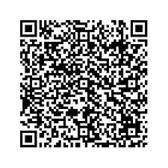
Design Approach (merging affordances of paper and digital technologies)
[Parikh et al. CHI 2006]
Notes:
QR codes – see Tapan S. Parikh, Using Mobile Phones for Secure, Distributed Document Processing in the Developing World, IEEE Pervasive Computing Magazine, Vol. 4, No. 2, April 2005

Slide 19
Assignment 1

Slide 20
Assignment 1 – General Feedback
Some problems:
Applying theoretical frameworks wholesale – awkwardly forcing a fit; suggesting that an author would simply ‘agree’ or ‘disagree’ with a statement (about iPads or laptops)
Distinguishing approach (user heuristic) from substance (history of the telephone to 1940)
Selectively extracting a single extreme statement that does not reflect fully the author’s argument…be sure read and understand the sentences you cite in the context of broader arguments (i.e. Heilbroner)

Slide 21
Assignment 1 – writing issues
For a short word count, cut excessive introductions, pointless details
Though you had limited word count, we still expect you to explain/unpack the claims made in your essay responses in enough detail to justify their logic. Theoretical concepts often needed to be explained with more precision and clarity
Look at your paper to see if we suggested that you go to the writing center at Academic Services. Please do so before turning in the next assignment
Look at examples of exceptionally well-written responses to essay questions (to be provided)
Consult a writing guide (to be provided)
Notes:
What defines a relevant social group is a shared interpretation of a technology (not automatically the case that users = one relevant social group and non-users = another relevant social group)

Slide 22
Assignment 1 – Part II
Final Paper Topic
Secondary sources only - should be a topic you can examine without collecting primary data (i.e. relying on existing published accounts) [data collection and analysis requires a whole separate set of skills – see qual or quant research courses or needs and usability assessment]
Scope – too broad a topic or one where there is a huge amount of research to wade through
Relevance to 203 – cite specific concepts or theoretical frameworks from this course
Feedback Notes Will Be Posted on Course Website

Slide 23
Assignment 1 – Grading
Scoring
(1) answering the question fully (2 pts)
(2) handling of course concepts (2 pts)
(3) logic of your claims and argument (2 pts)
(4) extension of course concepts (1 pt)
11.5 – 15+ is an A-range grade
8.5 – 11.499999 is a B-range grade
At or below 8.5 – need improvement on future assignments, please come talk to us for help
GSIs: EO = Elisa Oreglia, SG = Stuart Geiger, JS = Jen Schradie – contact the GSI who was principally responsible for grading your assignment. PhD students come talk to me.
Feedback Notes Will Be Posted on Course Website

