Slide 1
Session 3
Technological Determinism (and critiques of), Methods and Evidence, The history of the telephone in America

Slide 2
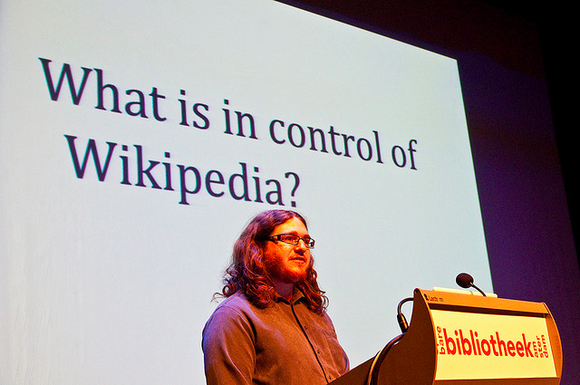
Stuart Geiger

Slide 3
Reading Workshop
Wednesday Feb 6, 5pm – room TBD
Save time, go deeper into the course readings
Totally voluntary…for those who find the format of our readings to be unfamiliar, find the amount of reading to be heavier than you are accustomed to, etc.

Slide 4
From Thursday
That many of our most popular social media tools are not especially in tune with insights from social research (an opportunity)
“people have very nuanced behavior concerning how and with whom they wish to share information. People are concerned about whether to release this piece of information to that person at this time, and they have very complex understanding of people’s views of themselves, the current situation, and the effects of disclosure.”
– Mark Ackerman (citing Sociologist Erving Goffman)
“Having two identities for yourself is an example of a lack of integrity” – Mark Zuckerberg
Notes:
Zuckberg’s normative stance about how we “should” be vs. the weight of social research that suggests we do not present one face, one identity. Opportunities to tweak the social networking format.

Slide 5
Technological Determinism
(HARD) technological determinism: science develops according to an internal and purely rational process and technology is the application of science. Technological inventions enter into society, are taken up according to an economic rationality and consequently produce a social impact.
R&D
Science
Tech
Society

Slide 6
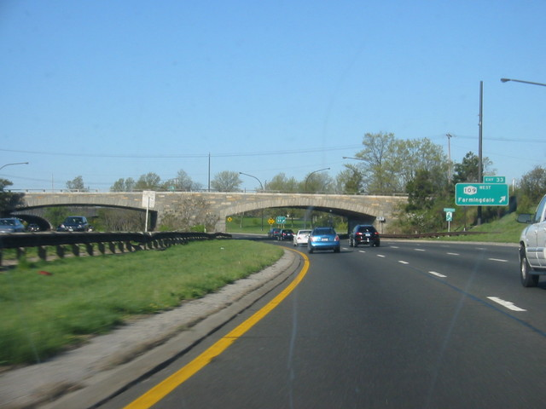
Can a bridge be prejudiced?
How ‘artifacts’ matter:
Consequences beyond those intended by designers/ builders
Fixedness of form, “flexibility vanishes …once the initial commitments are made.”
Notes:
A way of thinking about technology’s consequentiality that is not so rigidly deterministic

Slide 7
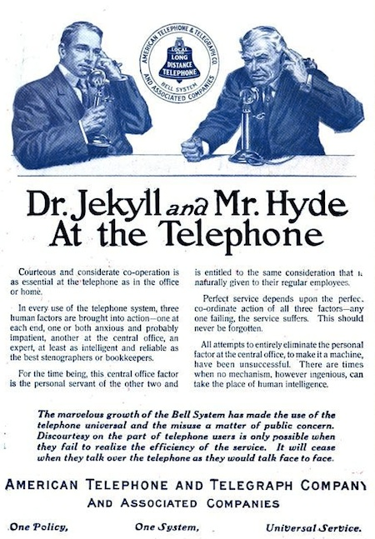
Social History of the Telephone
Claude Fischer, America Calling
Chapter 1 “Technology and Modern Life”
Chapter 3 “Educating the Public”

Slide 8
Why look back at historical cases?
We know how the story ends
View more dispassionately than present-day technologies
See the full scope of this recurring pattern over time: invention → marketing → adoption → adaptation → eventual, settled role.
Notes:
What is there to learn from the history, especially that period just after the introduction of a now commonplace technology?

Slide 9
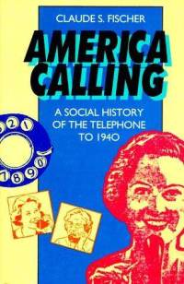
Readings / How to Read
Empirical
Academic Publications
Statistical analysis
Qualitative – ethnographic, interviews, case study
Non-empirical
Summative Evaluation (of a research field, perspective)
Present a Concept / Vision
Present a Design Solution
Argumentative Essay

Slide 10
Empirical Work (broad definition)
Makes claims to knowledge drawing from primary source materials (data) that have been systematically collected and evaluated.
vs. argumentative essay
Notes:
Let’s tackle that first question – is this empirical?
Primary source materials – you the researcher collected them (or perhaps in data repositories that you are analyzing)
The difference between an empirical piece and an argumentative essay
What distinguishes Fischer and how he makes his argument from Winner and how he makes his argument (one is an empirical work, the other is an argumentative essay)
The argumentative essay asks you to agree to a set of first principles and then makes a claim working step by step logically from those principles. An argumentative essay may offer compelling examples, but not ones that are collected in any particularly systematic way. An argumentative essay invites critique principally based on its internal logic. You critique such an essay by showing a mistake in logic, an alternate logic that is equally or more convincing, or by presenting some other compelling examples that counters the claims of the essay. You can also use empirical research to challenge an argumentative essay, but not to say “I collected data and you didn’t” but to show how your empirical findings refute the first principles, counter some element of the internal logic, etc of the essay.
An empirical piece always entails interpretation (data does not interpret itself!) and argument (the most stringently quantitative work – economic models, etc do not escape this). When someone does an experiment or carries out a survey they can show you patterns in the resulting data, something that is statistically significant – but then they use logic and argument and theory to suggest what it means.
What does systematic mean? For mainstream positivist science and for experimental research there are some tricks you can rely on – random sampling, double blind, tests of statistical significance. Different fields (given their different research interests and methods) have different ways of checking any inadvertently biased selection process.
For archival research, for qualitative approaches…there are still all kinds of efforts at systematic selection (though random sampling may not be possible), thoroughness, seeking counterexamples, looking for evidence of alternative explanations.
Part of being systematic - Peer review and competition is one. A different set of eyes to review the claims critically.

Slide 11
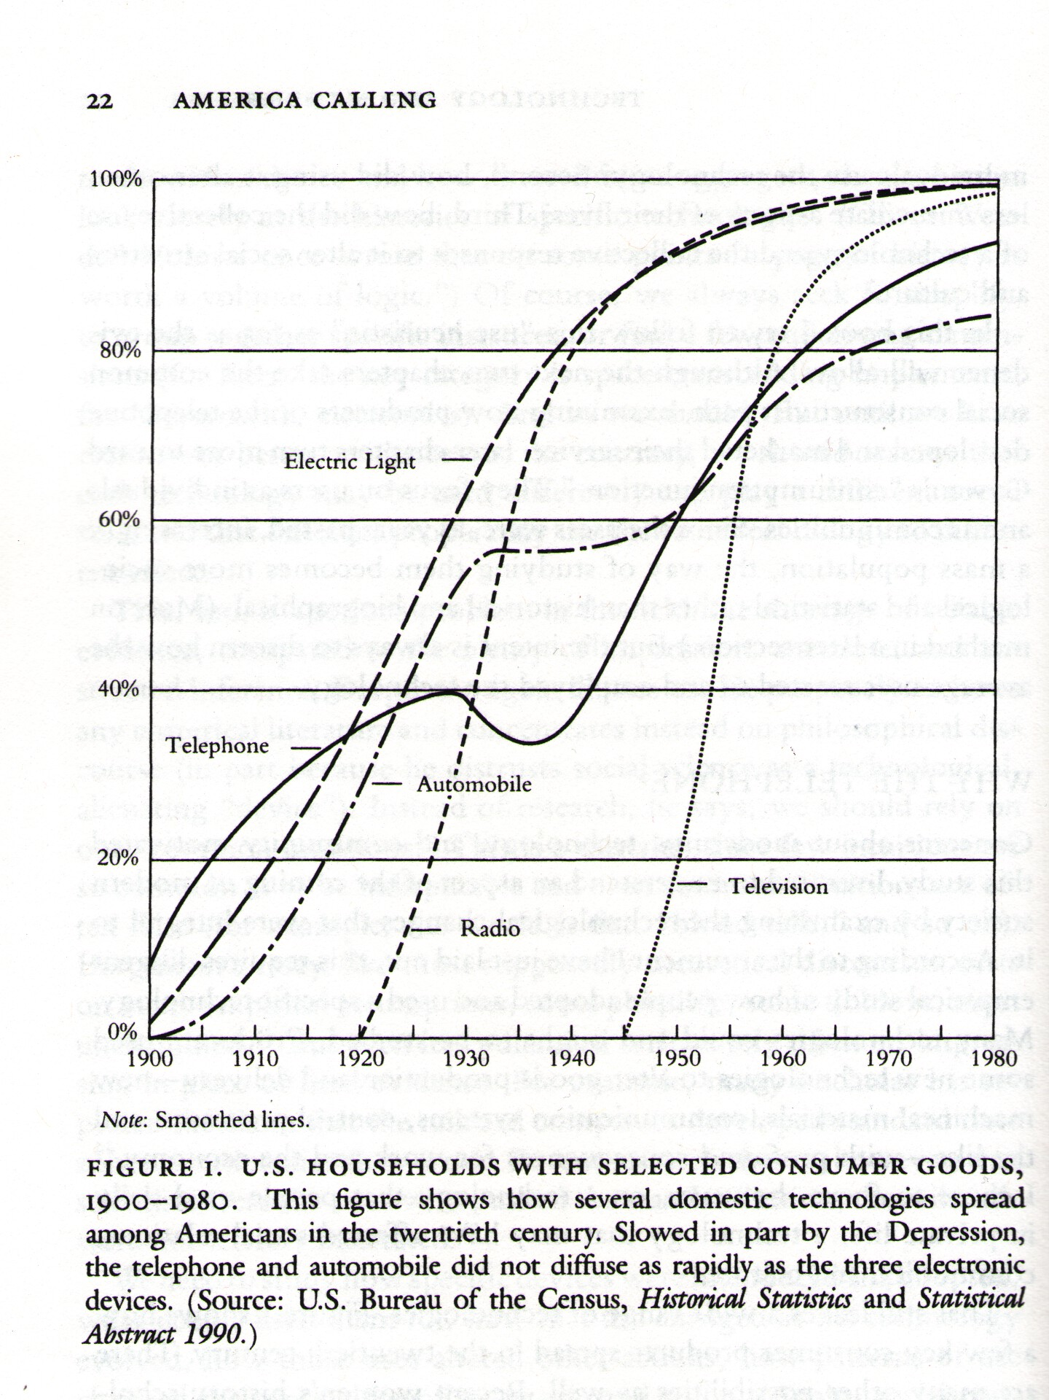
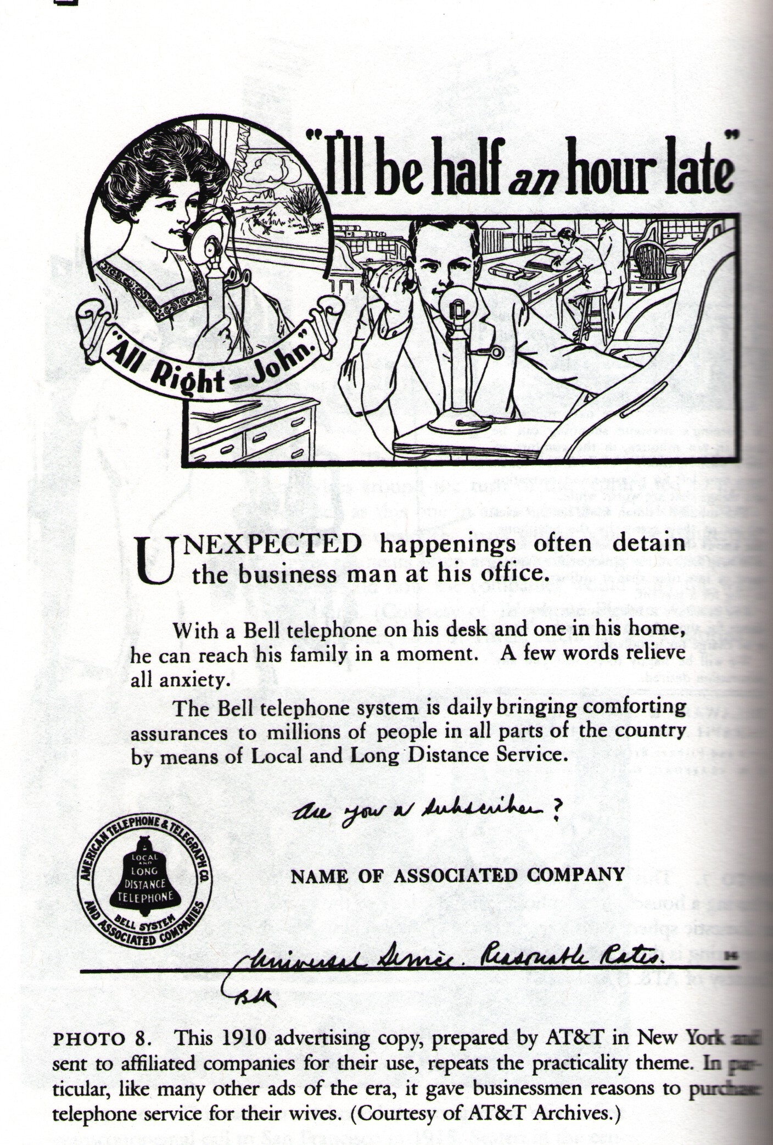
Evidence, Facts
Notes:
Which of these prevent evidence or facts? Answer BOTH.

Slide 12
Look at the evidence and sources for Fischer (Chap. 3). Discuss any questions, concerns.
Notes:
What is systematic here (methodical) –
Documentation of sources (for interested parties to go and check)
Effort to get at as many kinds of relevant sources as possible – traveling to archives, etc (he didn’t just Google)
Thoroughness of review

Slide 13
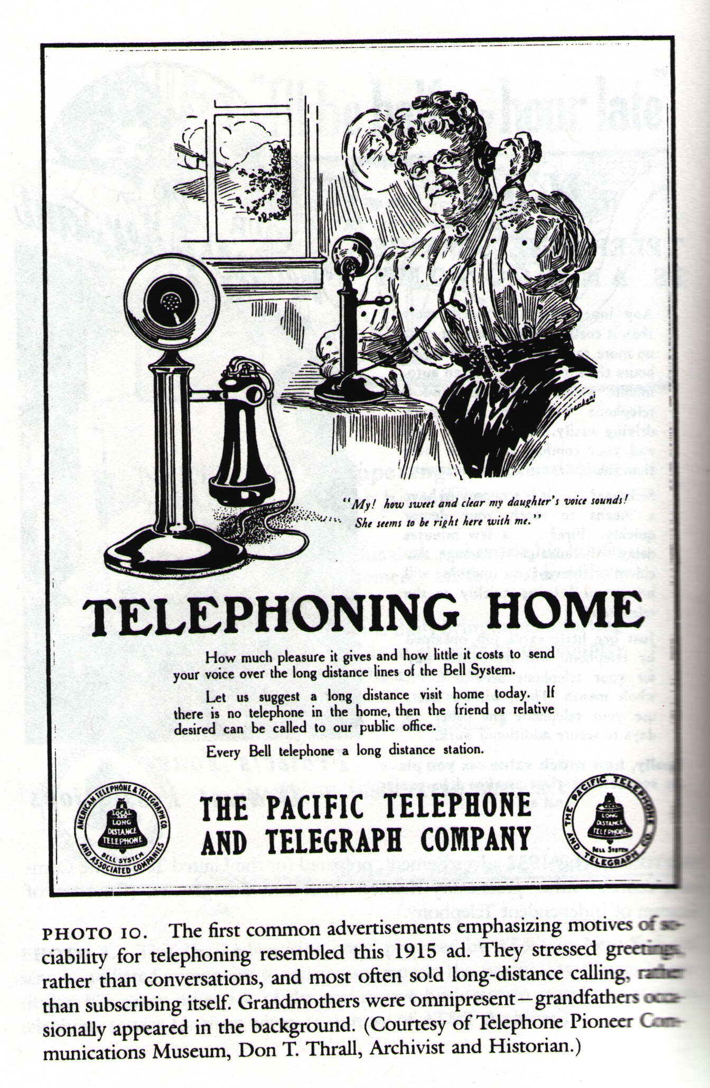
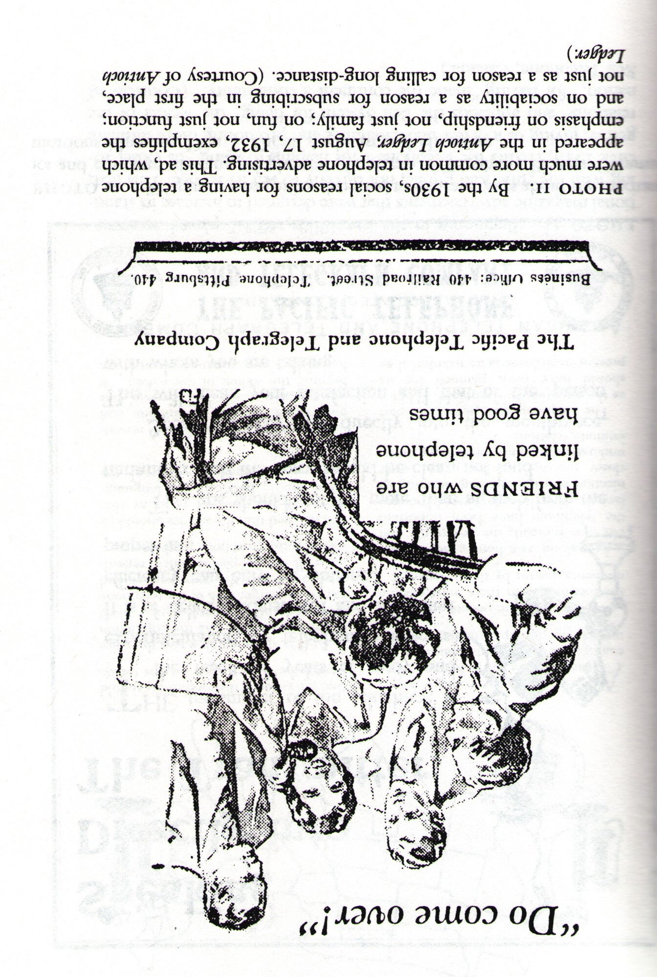
Interpretation
1910
1915
1930s
Notes:
What does he do with the evidence? He’s talking about the weight of the evidence. Recurring themes and change in themes over time in a body of materials. Advertisements. Doing the best you can with what is available.
Looking at themes, messages constructed in language, meaning. To understand human language and its uses (as a product of culture) is inevitably about interpretation. That doesn’t mean interpretation is totally subjective, ‘arbitrary’ and can’t be critiqued, refuted. There are certainly better or worse interpretations. How are interpretations checked – he gives us the evidence, the source materials from which he derives the interpretation, then we judge for ourselves by looking at the advertisements or if we are really ambitious revisiting the archives from which these materials were drawn (transparency).
Peer review is critically important, scrutiny and competition in the discipline. A system designed to check and critique the work of others and to uphold standards. See the case of Michael Bellesiles, a historian over controversy in his source materials, etc.
http://chronicle.com/article/Michael-Bellesiles-Takes/123751/
These sorts of controversies of course also happen with researchers who use a more positivist, scientific method approach (falsified data).

Slide 14
Technological Determinism(s)
‘Billiard-ball’ model (Ogburn 1950s)
Comparing national trajectories – consequences are socially conditioned -- i.e. different trajectories for the trolley in different countries
‘Impact—imprint’ model – an essence or style to technology, technology transfers its qualities to users

Slide 15
Alternatives to Tech Determinism
Symptomatic approaches – tech as expression of culture, Geist – spirit of the age (rationalization in the industrial age)
Social Constructivism – struggle, negotiation over development and invention (see Bjiker bicycle next week)
Fischer’s “User Heuristic” – emphasizing user agency in realizing the unfolding consequences of technology

Slide 16
Chapter 3 – Educating the Public
Finding Uses
Demonstrating that it functions, getting people to pay
Early uses, long since forgotten
The emphasis of marketing
Managing Uses
Etiquette
Party lines
Court cases?
Discovering Sociability
A shift in marketing emphasis in the late 1920s
Industry attitudes toward sociability
Notes:
“the fact that subscribers have been free to use the wires as they pleased without incurring additional expense…has led to the transmission of large numbers of communications of the most trivial character”
….”purely idle gossip” and need to reduce this last unnecessary use”
“of course, well understood that business conversations cannot be limited as to time, but ‘visiting’ can beneficially be confined to a reasonably short duration of time.”
The uses demonstrated to telephone company (AT&T) execs by users persistence…(rather than the other way around)

Slide 17
The Claim (of chapter 3)
“although sophisticated in their method of introducing the telephone, persistent in finding business clients, and eventually skillful at public relations, the marketers of telephone service were slow to employ as a sales tool the use that was to dominate the home telephone’s future, sociable conversation.” (Fischer, pg. 85)

Slide 18
The Explanation (the why)
“in promoting a technology, vendors are constrained…by an interpretation of its uses that is shaped by its and their histories, a cultural constraint that can persist over many years.” (Fischer, p. 85)
Notes:
By analogy to the telegraph
Understanding by analogy – something to watch out for, I’ve seen it in my own work as well. A prior model as a basis for the new tech. Arrive at understanding and a sense of how to proceed efficiently, but also conceptually limiting.

Slide 19
On the theme of “users in society”
Turing Complete User – Olia Lialina
How did the term “user” get such a bad rap?
The danger in denying the term
Turing Complete Users / the General Purpose User: users who have the ability to achieve their goals regardless of the primary purpose of an application or device
Fischer on the telephone -- “the consequences of the technology are the ends that users seek”
Notes:
Readings about the agency of users…usability design, UI design not about spoon-feeding, hand-holding through tasks
The uses of ambiguity, open endedness in design

Slide 20
What questions for further investigation can you extract from this graph? Support or call into question a technological determinist view?

