Slide 1
Session 2
The Sociotechnical Gap, Do Artifacts Have Politics?
Notes:
Three readings that cover a lot of ground, tackle broadly problems of how humans and machines relate to one another, or how we get by in a world that has been quite altered by the spread of various “information technologies”. Readings tackle this from very different angles. Each identifies a different set of problems.

Slide 2
Categorizing the Readings
Empirical
Academic Publications
Statistical analysis – experimental designs, surveys
Qualitative – ethnographic, interviews, case study
Non-empirical
Summative Evaluation (of a research field, perspective)
Present a Concept / Vision
Present a Design Solution
Argumentative Essay
(5 minutes)
Notes:
To start, spend about 5 minutes or so talking to one another about where the readings fit within this categorization structure

Slide 3
3 Ideas for handling machine/human relations
Automate – replace tasks carried out by humans with machines
Delegate – recognizing the differing characteristics of machines vs. humans, play to the strengths of each (the socio-technical gap)
Make machines human-like to facilitate natural, effortless communication between
Examples? In what circumstances is each approach called for?
Notes:
Some ideas for information scientists, designers, builders working at the interface between humans and computational machines

Slide 4
The Socio-technical gap
And some key findings from the field of computer-supported cooperative work (CSCW)

Slide 5
The socio-technical gap (Ackerman)
Digital technologies now play a key role in supporting the social world & in mediating social interaction. Yet such technology is unable to fully support social activity in all its flexibility, nuance, and context-specificity.
We can improve technology but Ackerman suggests its likely the gap will never be entirely closed
Notes:
what it suggests about design is an approach oriented toward delegating rather than automating … especially when it comes to social, interactional ??

Slide 6
The socio-technical gap (Ackerman)
What the socio-technical gap is NOT:
NOT simply the difference between what technology can do and what we want it to do (…because this difference is not necessarily social)
Not our ability to understand technology and use it (skills) vs. what the technology is capable of

Slide 7
Identify some examples of the sociotechnical gap (15 minutes)
Has the use of a digital technology ever lead you to commit a social gaffe? Created some trouble in your social relationships (personal or professional)?
What is Ackerman’s general explanation for what is going on here?
Could this be avoided through a design change?
Notes:
Some examples:
Ackerman’s general explanation…technology requires us to be explicit about things that we simply know.

Slide 8
Lessons Learned in CSCW (tips from Ackerman)
Norms emerge for use in CSCW systems, and these norms tend to be constantly re-negotiated.
Critical Mass problems (related: network effects)
Importance of Incentives for participation and contribution in collective effort systems
The data entry burden

Slide 9
Lessons Learned in CSCW (tips from Ackerman)
Exceptions tend to be the norm in work processes
common mistake in system design … task flow or decision support that aims to anticipate and encode all possible work flows.
People prefer to know who else is present in a shared space and how they are performing
E.g. Air traffic controllers anticipating future workflow
Visibility of communication and information (tricky, the politics of concealment)

Slide 10
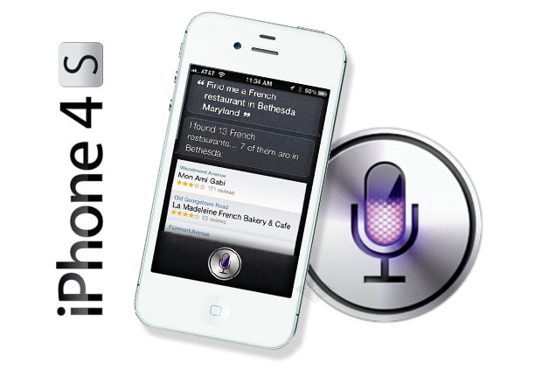
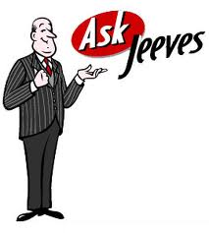
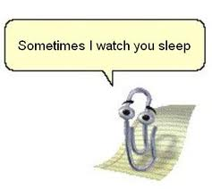
Anthropomorphism as a Design Feature
Notes:
What inspires this design choice?
What does the research say?
Is it always a bad idea? Why or why not?

Slide 11
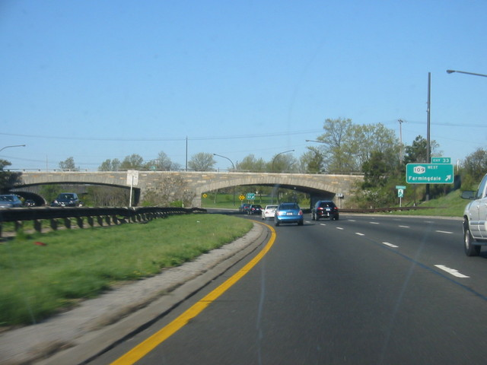
Can a bridge be discriminatory?
Notes:
is this what Winner meant when he talked about the overpasses of Long Island designed by Robert Moses?

Slide 12
Take home
Many of our most popular social networking / social media tools are not especially socially informed (an opportunity)
“Having two identities for yourself is an example of a lack of integrity” – Mark Zuckerberg
“people have very nuanced behavior concerning how and with whom they wish to share information. People are concerned about whether to release this piece of information to that person at this time, and they have very complex understanding of people’s views of themselves, the current situation, and the effects of disclosure.”
– Mark Ackerman (citing Erving Goffman)

