Slide 1
Administrative
Final Paper Assignment Sheet:
7000-8000 words (that is the full range no + or – on the word count)
Word count is without bibliography but including in-line citations

Slide 2
Session 25
Intercultural Communication on the Internet
Notes:
Address Raymond Williams comment that “culture is one of the two or three most complicated words in the English language”

Slide 3
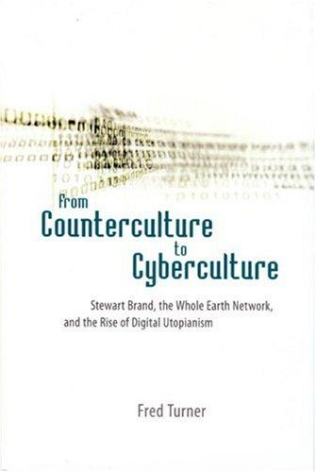
Are online cultures rooted in aspects of American culture? Or particular American subcultures?
Notes:
See also “Cyberspace as American Culture” (2002) by Phil Agre

Slide 4
Outline
Review of “culture” with a focus on its connection to information systems and technology
Values in Design
Cultures of Mobile Phone Use
Intercultural interaction
Call Center Workers in India
Ghanaian Youth in Yahoo! Chat Rooms

Slide 5
Culture (Etymology)
As a “general process of intellectual, spiritual, and aesthetic development” [cultivation, civilization]
As “a particular way of life, whether of a people, a period, a group, or humanity in general”
As “the works and practices of intellectual and especially artistic activity” [endures especially in French, Italian]
Notes:
In the middle – our rough definition

Slide 6
Culture: Old and New Topics
Classic:
Kinship
Rituals, life-cycle events
Childrearing practices
Gifting (as separate from economic exchange)
Religious cosmologies, mythology (stories of origins)
Moral codes (distinguishing good from bad)
Recent:
Subcultures (of youth, network gaming and online communities, organizational)
Religious syncretism
Global circulations and globalization
Migration
Notes:
What is a “particular way of life” composed of?
Special events as well as the everyday
Moving from a sense of culture as being distinguishable by sharp boundaries, best found in communities “isolated” from western influence

Slide 7
Culture
Geertz – “an historically transmitted pattern of meanings embodied in symbols, a system of inherited conceptions expressed in symbolic forms by means of which men communicate, perpetuate, and develop their knowledge about and their attitudes toward life”
Tylor (1871) – “that complex whole which includes knowledge, belief, art, law, morals, custom, and any other capabilities and habits acquired by man as a member of society.”
What is not culture? (1) pure behavior apart from the shared meanings attached to it. (2) idiosyncratic meanings and activities (that are not shared) (3) what is instinctual rather than learned
Notes:
It is habit
It is not just behavior, but the meaning attached to those behaviors, their significance
It is shared (not idiosyncratic)
It is learned, trained into members (not instinctual)
It is whole way of life (not isolated variables, but complex interrelationship)

Slide 8
Culture + Technology
In Design; In Use
Notes:
If we are studying digital technologies or information systems, how is culture relevant to our concerns?
That people from different cultural contexts may not respond in the same way to the same systems, artifacts – we may need to market to them differently, may develop products with different features or options.
The cultural prohibition against earning interest on invested money in Islam – leads to Islamic banking.
In design and in use. To harness and be more aware of

Slide 9
Values in Design (Nissenbaum)
In the design of a particular artifact or system:
Locus of control centralized or decentralized?
Workings transparent or opaque?
Support balanced terms of information exchange
Unfairly discriminate against specific sectors of potential users?
Enhance or diminish the possibility of trust?
Notes:
Ethics
Keeping in mind that notions and practices of morality as culturally variant. Being explicit about questions of values and criteria (beyond the technical) in the design of things.
Nissenbaum reading…introducing ethics. Lack of criteria for evaluating technology on social, political, ethical criteria (only technical…and economic).
Ties to tech and development or tech and poverty movement
A second key feature of VID work is its pragmatism. It is not enough to demonstrate that values are expressed through design decisions. Thinking about values should be included among the set of aspirations that guide and constrain the designs of all technology. If we accept that technology can embody values, let those who design and produce systems take values into consideration as they engineer these system components. The VID framework therefore places ethical and political values on the same plane of importance alongside technical and functional specifications and constraints.
Ethics:
Locus of control centralized or decentralized?
Workings transparent or opaque?
Support balanced terms of information exchange
Unfairly discrimianate against specific sectors of potential users?
Enhance or diminish the possibility of trust?

Slide 10
Cultures of Mobile Phone Use
“Link-up” In Jamaica – kinship and extremely broad social networks within which ties are revitalized lightly. The economic not divorced from the social.
Kawaii culture, phone personalization in Japan, ties to animals in Buddhism, gift giving, etc.
Flashing/Beeping/Missed Call phenomenon connected to scarcity, expense, monetary flows (India, Africa, etc.)
[Culture materializes technology in a particular way through forms of use] (See theories of domestication, appropriation)
Notes:
Culture not as outside of material/mechanization, but expressed in ways of engaging with features.
Culture materializes technology in a particular way through forms of use.

Slide 11
Intercultural communication
In Networked Spaces
Notes:
A very new, fresh topic on which there is very little published research.
Related to this idea that in online spaces people come to develop emergently a distinct subculture (which we’ve talked about at length in section 3).
What cultural influences form these emergent online subcultures – not emerging out of nothing, but what? New demands of the online environment, properties of networked publics? Also, the cultural practices of the populations who come to inhabit online spaces. ‘cyberspace as american culture’ as Phil Agre once wrote about.
Now with the Internet becoming a more truly global phenomenon, with a wider diversity of people encountering one another, what emerges?

Slide 12
On Indian Call Center Workers
Not just an encounter on equal terms between call center workers and American callers. There is the multinational corporation, the employer that sets the terms of that encounter (literally a script).
“globalization does not exist in some rarefied stratosphere. It always touches the ground.” – (Brah 2002)

Slide 13
On Indian Call Center Workers
“Scripted service work” and “language trafficking”
Synchronicity – “colonization with time”
Locational masking
What views on the work emerge among workers? On American customers? On the work itself as a job for young college educated Indians?
Notes:
A reflection of the terms – employment in a multinational corporation set with a certain, a clientele who need to be satisfied.

Slide 14
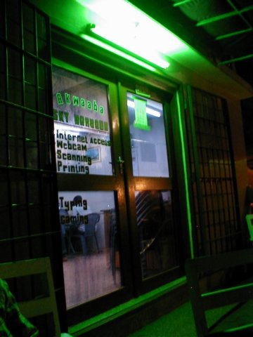
Ghanaian Youth in Yahoo Chat Rooms
Seeking pen pals:
Friends / Peers
Romantic partner / Marriage Opportunity
Patrons, Sponsors
Business partners
Philanthropists
Much like ‘Link-up’ practices in Jamaica

Slide 15
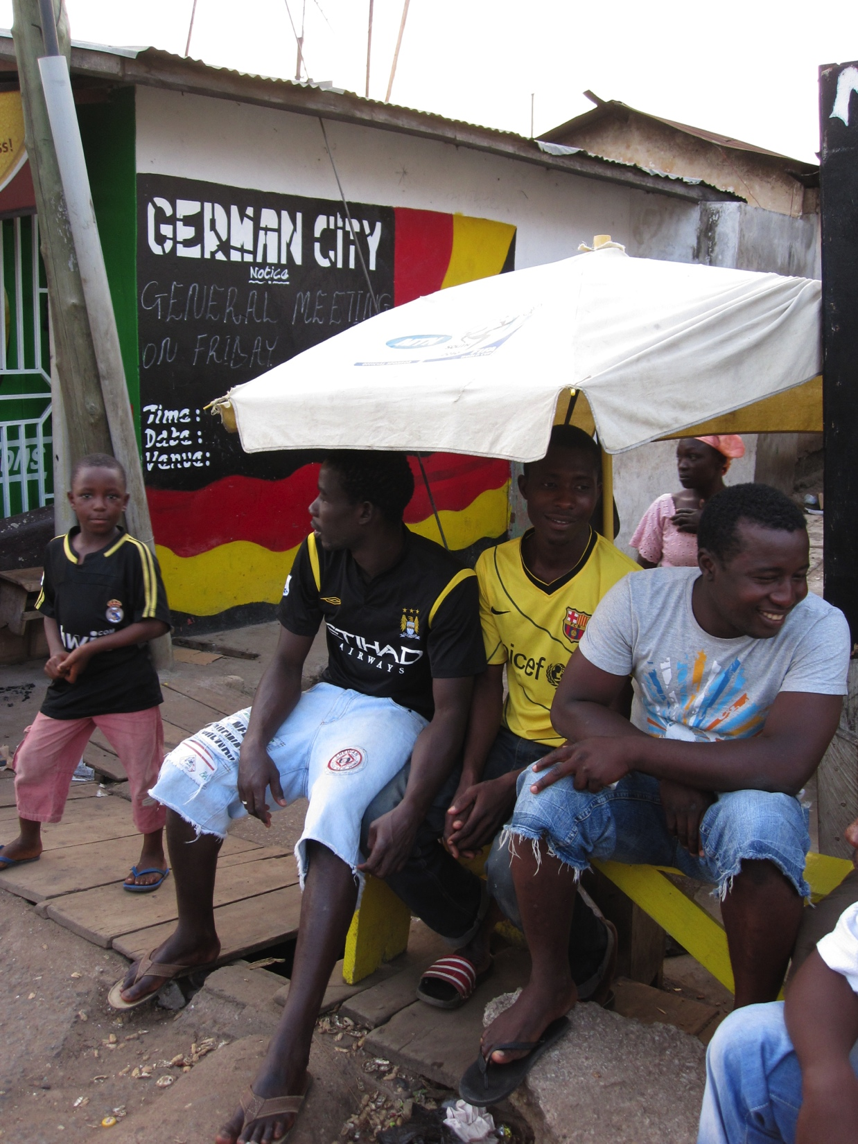
Ghanaian Youth in Yahoo Chat Rooms
in general, an outward-oriented society (particularly among educated, urban youth)
symbols and role-models on display in urban space (Obama, but also Gaddafi)
a kind of cosmopolitanism-in-place

Slide 16
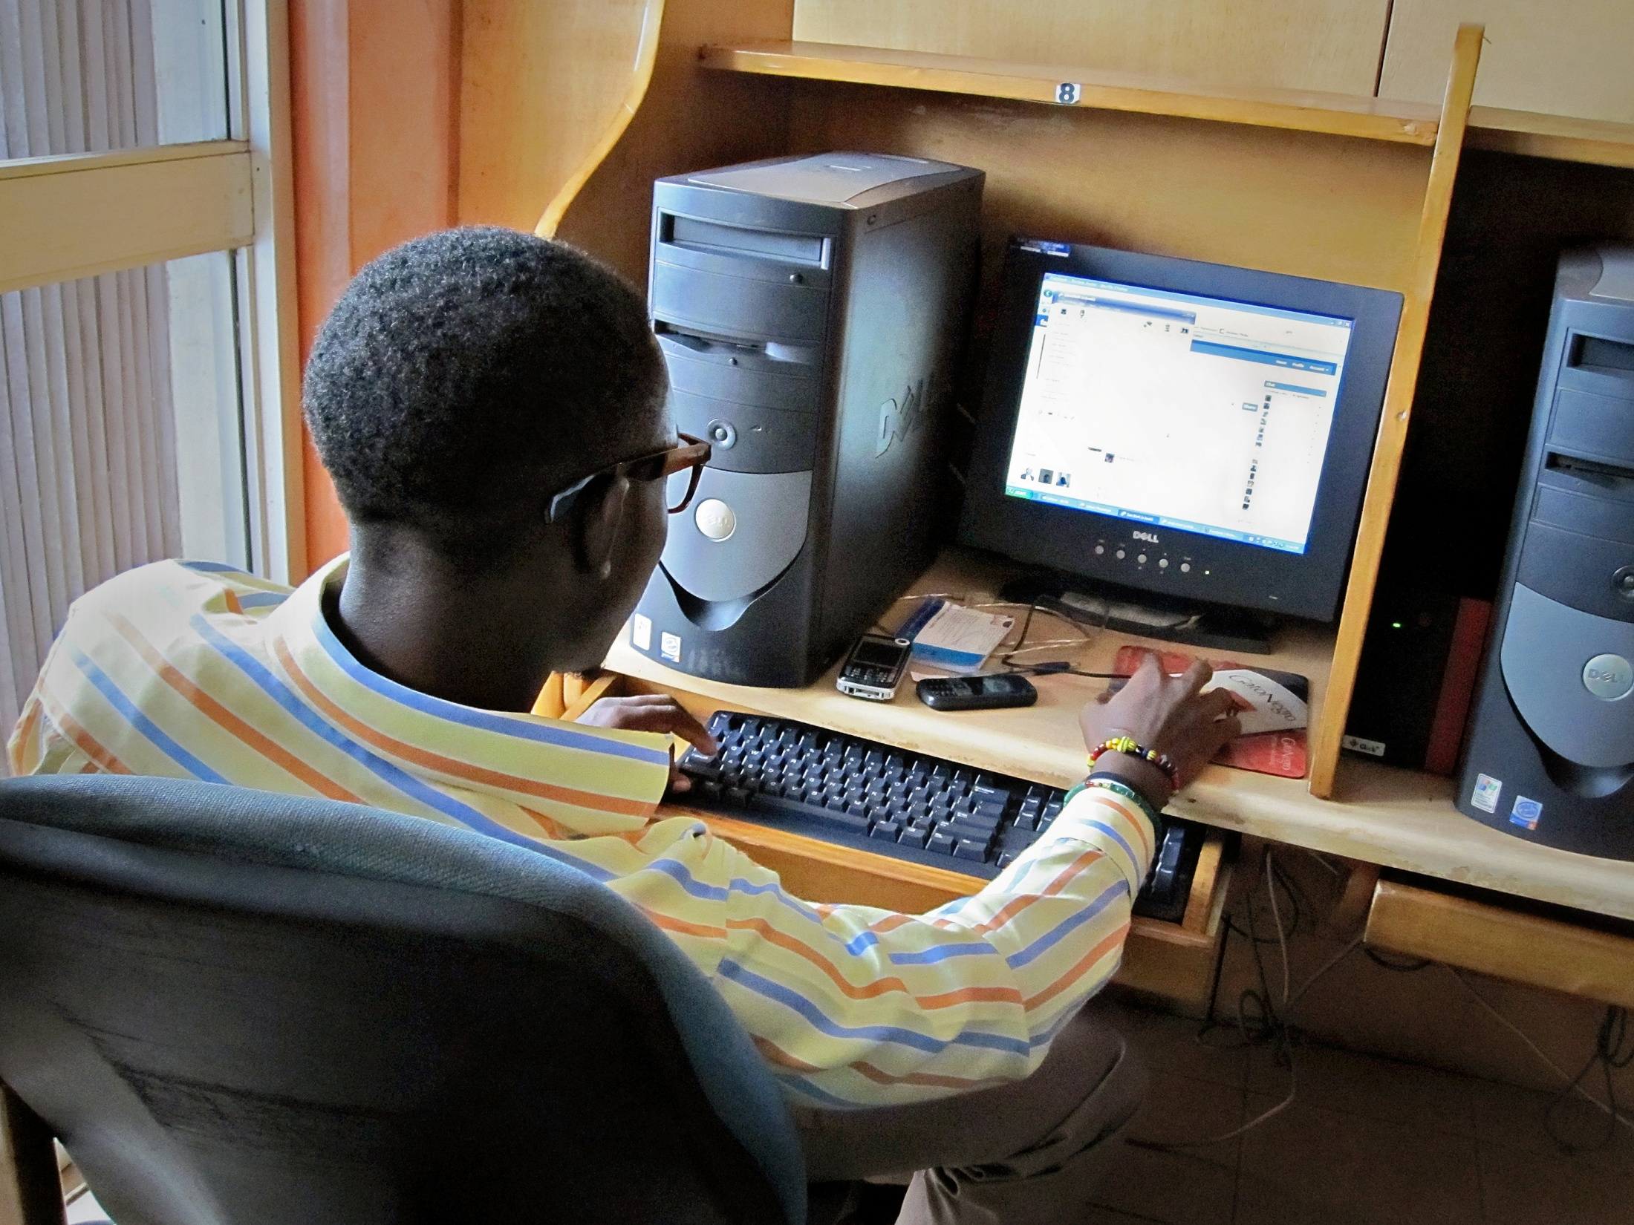
Cultural Discontinuity
Divergent Baseline Understandings
Gender and communicative norms
Moral economy of gifting
Obligation and hospitality
Complicated by
Material Asymmetries (rushed encounters)
Simplistic Perceptions about Western Affluence

Slide 17
Summary
New kinds of intercultural encounters mediated by network infrastructure – characterized by disruption, discontinuity, confusion, breakdowns
Indian call center: existing in an alternate time zone, performing language (accent) and locational ambiguity
Ghanaians in chat rooms: Banning, blocking functions as opposed to pressure for tolerance
Such encounters defined by different projects, purposes that position communicating pairs unequally
Indian call center: employer-defined, customer satisfaction
Ghanaians in chat rooms: general interest in abroad, seeking social ties and (via these ties) opportunities

