Slide 1
Session 10
The Myth of the Paperless Office
Toward Paperlessness?

Slide 2
The Myth of the Paperless Office
Background:
The state of digital technology in 2002 (in the US, UK)
The Desktop PC still the primary device for many office workers
Laptops were becoming widespread (+ for home use: iMac)
PDAs (Palm Pilot, Dell Axim) but no smartphones
No iPad (tablet market not yet born)
eReaders (RocketBook? Not mainstream – eInk still under research), Apple Newton – a false start.

Slide 3
The Myth of the Paperless Office
Also in 2002…
Apple’s Chief in the Risky Land of Handhelds “now come signs that Mr. Jobs means to take Apple back to the land of the handhelds, but this time with a device that would combine elements of a cellphone and a Palm-like personal digital assistant…industry analysts see evidence that Apple is contemplating what inside the company is being called an ''iPhone.'’”
(August 19, 2002, NY Times)

Slide 4
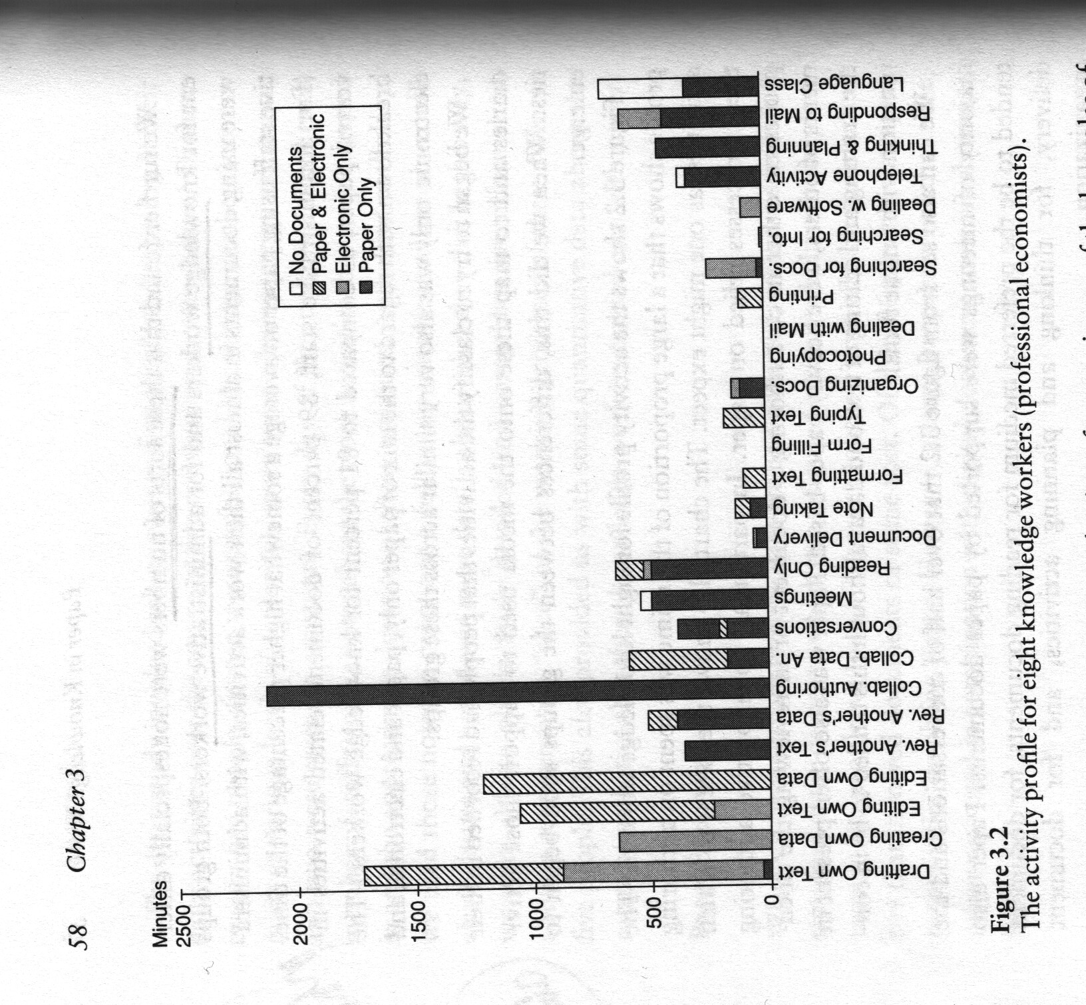
The Myth of the Paperless Office
Background:
Method in Myth of the Paperless Office
Mixed method approach
Primary and secondary data

Slide 5
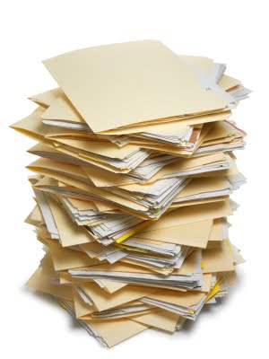
The Myth of the Paperless Office
What’s Wrong with Paper?
Symbolic problems
Cost problems
Interactional problems

Slide 6
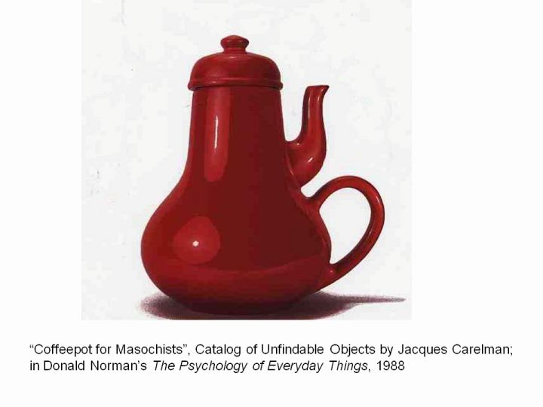
Key Concept: Affordances
Affordances are about “how the properties of objects determine the possibilities for action” – Myth of the Paperless Office
The affordances of paper vs. the affordances of existing digital devices (circa 2002)
Two ways of talking about affordances – (1) Gibson/Norman (related to usability) vs. (2) in The Myth of the Paperless Office
Notes:
One version is about perceiving and reading a tool or technology to discover its uses. As much about perception as it is about actual properties:
Objects “contain visible clues to their operation” – Gibson
Affordance “the perceived and actual properties of the thing…clues to the operations of things” – in Norman’s book this is about how designs are made usable, by giving us clues in their form as to how to operate…without need for pictures, labels, instructions
In our book The Myth of the Paperless Office emphasis is on what we are more easily able to do with one technology or tool vs another:
“How the properties of objects determine the possibilities for action”
And the very interesting and novel approach of this book is to treat paper and digital technologies the same, to look at them symmetrically – without automatically privileging one form over the other -- considering and weighing the affordances of each. What is paper good for? What is a PC good for?

Slide 7
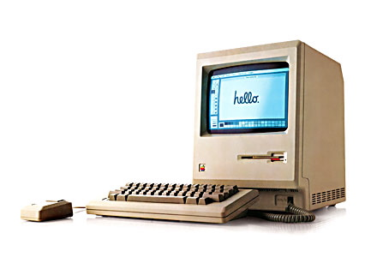
Key Concept: Affordances
Does paper or a PC better afford:
Carrying (weight and portability issues)
Reading from (eye strain, comfort)
Transferring information to someone
Storing data, information in (capacity)
Inscribing (writing or typing)
Annotating
Revising, Rearranging, Combining text
Viewing moving images
Use while away from power plug
Use in the Dark
Use in Bright Daylight

Slide 8
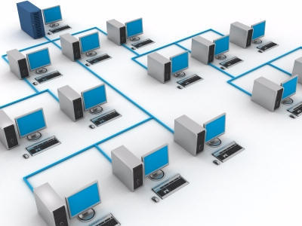
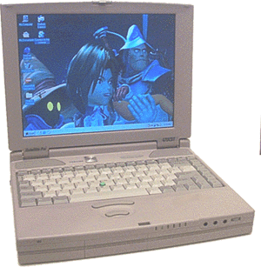
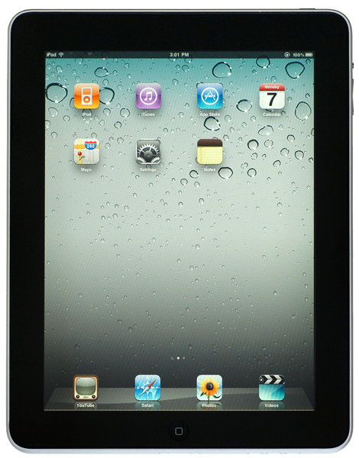
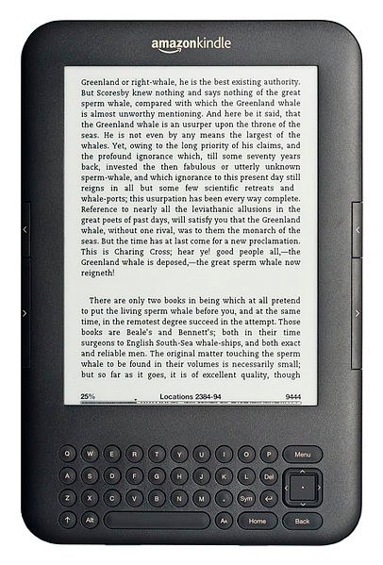
Toward Paperlessness?
Desktop PC (standalone)
Notes:
Possibly more paper use from the standalone computer without network capabilities because paper becomes a key intermediary between users. Furthermore interoperability issues – can’t easily pass documents in storage media given the whole IBM-PC vs. Apple.

Slide 9
Toward Paperlessness?
Networked PC

Slide 10
Toward Paperlessness?
Laptop

Slide 11
Toward Paperlessness?
iPad

Slide 12
Toward Paperlessness?
eReader

Slide 13
Notes:
http://spie.org/x17480.xml
Active matrix display technology
The technology in displays.
Allows for lower power consumption (cheaper, use for longer off the grid)
Static display rather than flickering refresh that is so hard on the eyes.

Slide 14
Critique of the Concept of “Affordances”
Useful to think in this way, to compare, gain clarity on the possibilities of paperlessness (i.e. under what circumstances digital devices might supplant paper, what barriers remain to that outcome)
Limits of this approach:
…context and specific work practices ignored in favor of thinking about fixed properties of tools/technologies
comparison suggests a choice must be made, but (to this day) we work with a combination of paper and digital devices
Notes:
The problem of thinking about this exclusively in this way though is that it is detached from the specific context of work practices.
Critique of…

Slide 15
Next Week
Methods
Tuesday: Quantitative Methods (guest lecture by Prof. Coye Cheshire)
Thursday: Qualitative Methods
The following week we will resume (and finish) The Myth of the Paperless Office

