Slide 1
Administrative
Assignment 1
Covered readings

Slide 2
Session 5
Social construction of technology (SCOT) framework
Notes:
Relate this history of the bicycle to the history of the telephone
Both histories, but very told in very different ways (but also some commonalities) – specifically attention to users in both cases
Bicycle case questions how the technological form of the artifact comes into being whereas the phone took for granted the technology’s form (as fixed) and considered how uses were discovered, managed, and how adoption of the technology followed from processes of marketing, etc.

Slide 3
Technological Determinism
(HARD) technological determinism: science develops according to an internal and purely rational process and technology is the application of science. Technological inventions enter into society, are taken up according to an economic rationality and consequently produce a social impact.
R&D
Science
Tech
Society
Notes:
Heilbroner vs. Bijker

Slide 4
Social Construction of Technology (SCOT)
Terms:
Relevant Social Groups
Interpretive Flexibility
Closure

Slide 5
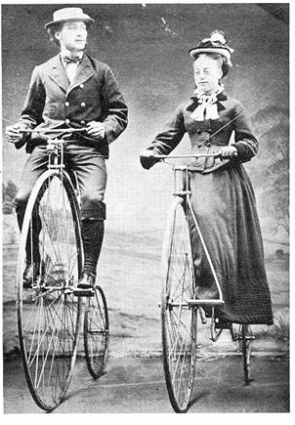
Social Construction of Technology
Athletic young men
Concerned community members
High wheeled bicycle
[Bijker on the bicycle]

Slide 6
The Invention of the Bicycle
Innovations
Pedals
Wire spokes
Metal vs. wood components
Large front wheel
Hollow front fork
3 wheels
Detachable handlebars
Chain drive
Antivibration gear
Pneumatic tire
Issues
Weight
Ease of mounting
Speed
Comfort/vibrations
Stability
Maneuverability
Cost
Aesthetics
Maintenance and repair
Decency/propriety
Notes:
How long did it take to sort out all of these issues? 60 years + / -?

Slide 7
Versions of the Bicycle

Slide 8
Social Construction of Technology (SCOT)
Terms:
Relevant Social Groups
Interpretive Flexibility
Closure

Slide 9
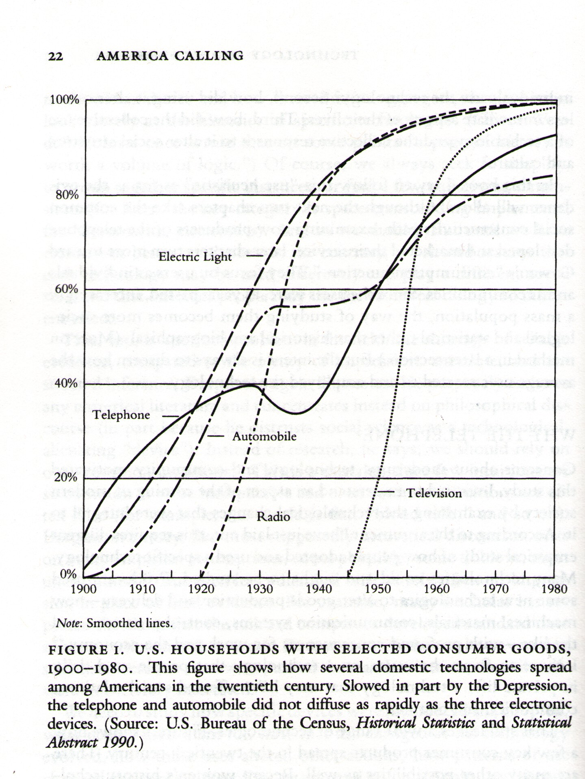
SCOT vs. Fischer’s “User Heuristic”
Notes:
How does this reading from SCOT change our perception, understanding of technology’s trajectory (uptake, diffusion) in society? Problems (or questions raised) about this graph? Would the history of the bicycle of we charted it look like this or different?
No sense of the ‘end game’ – the path of technology’s spread and uptake though at different rates and with – seems to end inevitably at almost total 100% diffusion.
A representation of tech history from which all failed technologies (or failed versions) have been excluded
What does obsolescence look like?

Slide 10
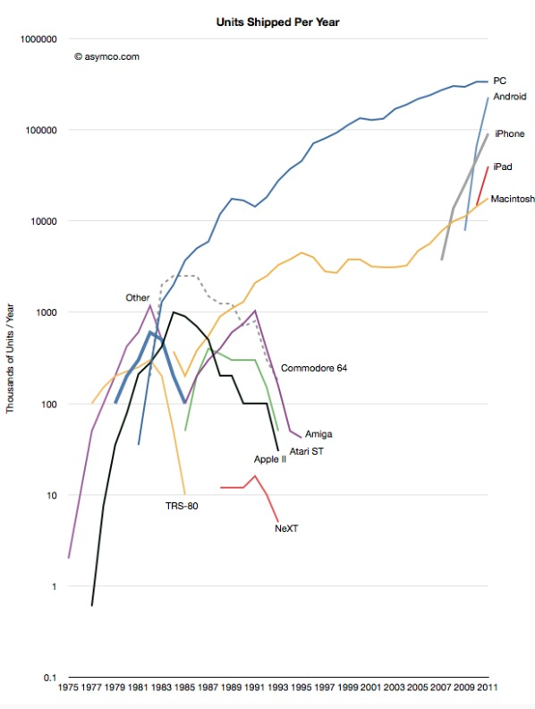
A more SCOT-like representation of a technology’s history of development and diffusion
Notes:
A map of the personal computer presented in a more SCOT like fashion
Here’s a map of technology diffusion that looks at the “also-rans” the full cycle, eventual decline of different versions of the form.
History of the computer and its uptake (source: Horace Dediu, Asymco)

Slide 11
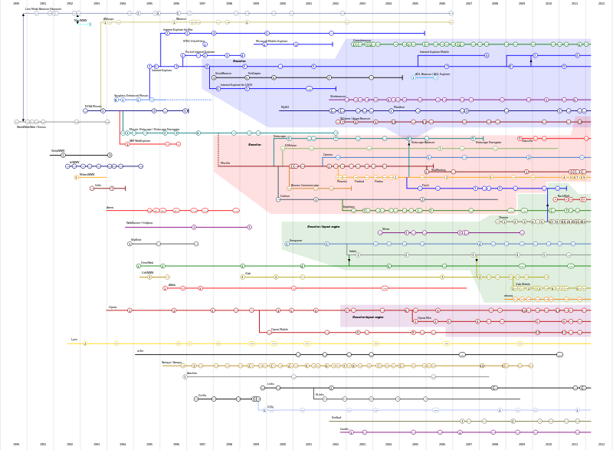
Notes:
In the present day what other processes look like this history of the bicycle. The “browser wars?”
Another kind of representation (this isn’t uptake, but it is something more like the history of the bicycle – with all of the messy variants represented in competition with one another).
A SCOT analysis of the browser wars (a potential paper topic)

Slide 12
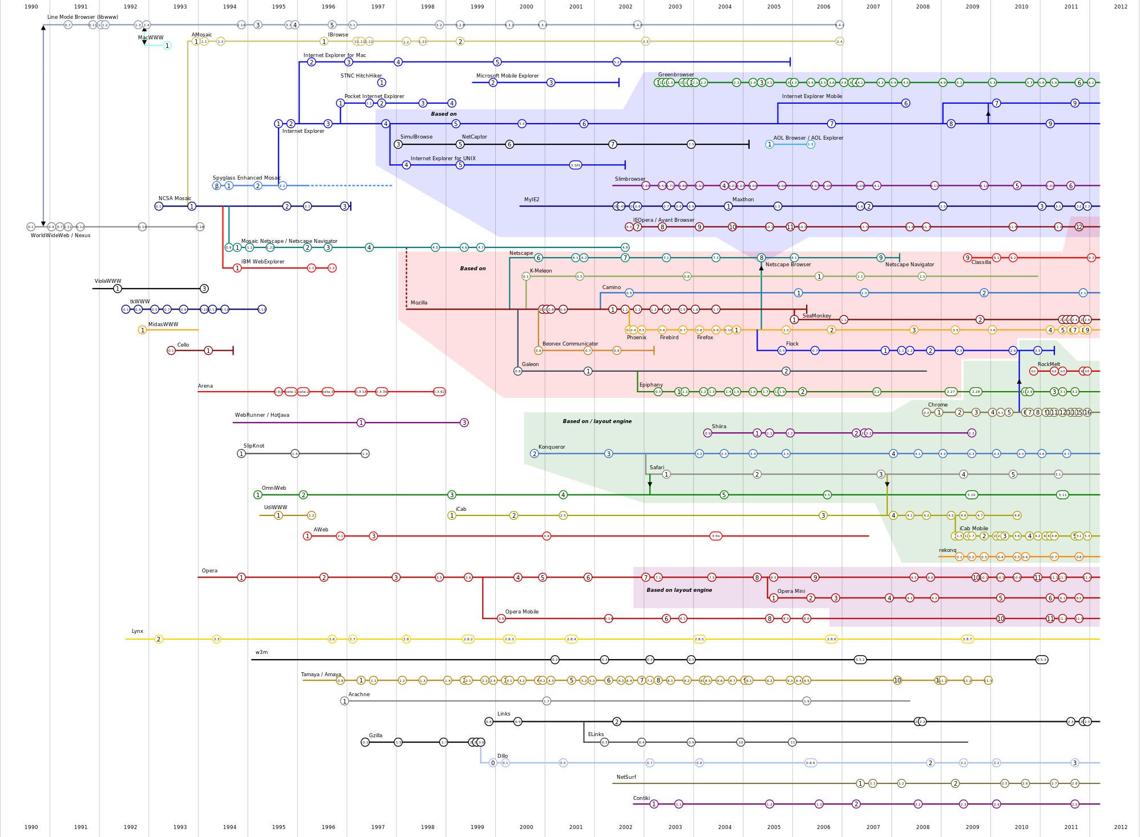
Notes:
Close-up
Source: http://en.wikipedia.org/wiki/File:Timeline_of_web_browsers.svg

Slide 13
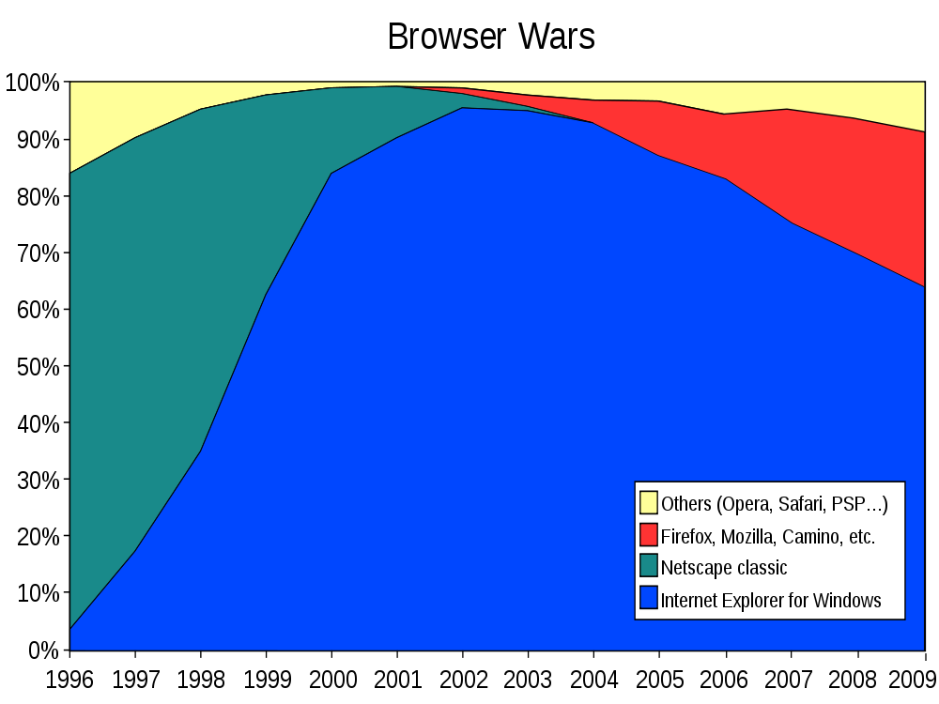
Notes:
Like the bicycle industry, a “competition for dominance in usage share” in the web browser market. The competition between the Ordinary / high-wheeled bicycle and the Safety bicycle (public races, etc). Competition settled in racing…two artifacts go head to head.
What are the relevant social groups? To what extent are user groups or other members of society (non-developers) driving this? To what extent is a logic of problem-solving involved – competing on features and enticing users? Not sure how well documented it is. Or rather business strategies like bundling, pressures of the court system, anti-trust. Interconnected with other tech purchases (laptop, OS, etc)
Closure? Toward 100% (IE) in 2002 and then away again.
Source: http://en.wikipedia.org/wiki/File:Browser_Wars.svg

Slide 14
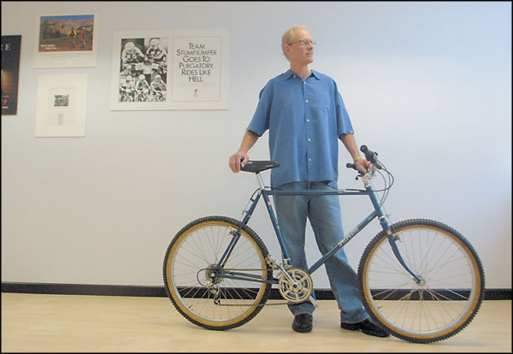
Critique of SCOT: Closure?
Notes:
As for the bicycle.
Closure?
Photo: Joel Turner
http://www.iwritewell.com/specialized.html

Slide 15
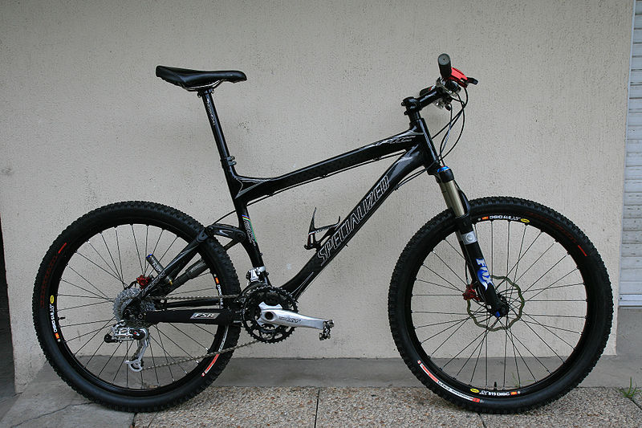
Closure?
Notes:
Mountain bike technologies continue to evolve – more adjustments for comfort (new pressure in this direction as users appropriate the bicycle for use on trails vs. pavement).

Slide 16
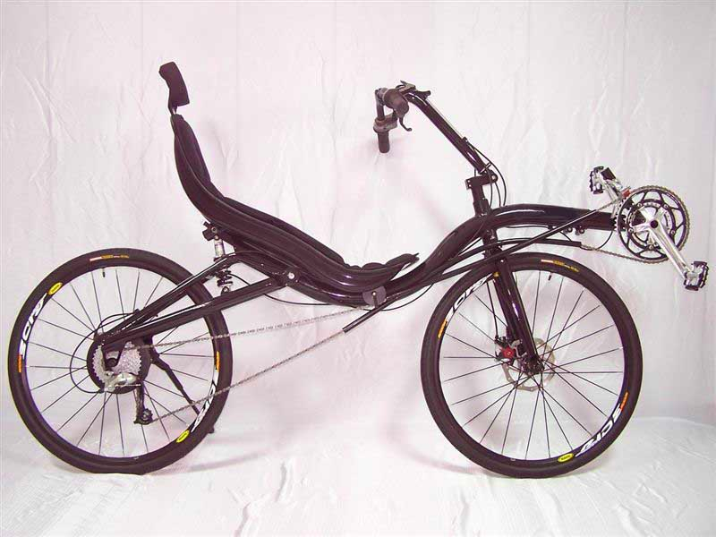
Closure?
Notes:
Recumbent bike – another comfort solution

Slide 17
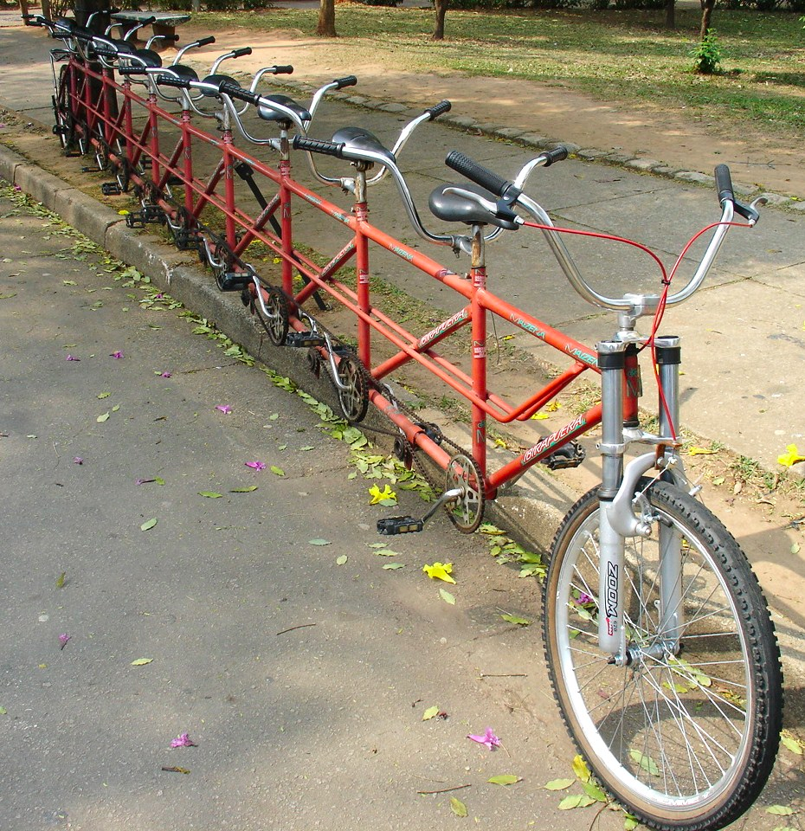
Closure?
Notes:
Tandem bicycle – more efficient use of power (double the pedaling power, but requires coordination between riders when going up hill)

Slide 18
Critique of SCOT: role of users in shaping technological form
Notes:
Perhaps not a critique, but a comment on the framing of SCOT – what it foregrounds vs. what it omits from consideration.
In SCOT – given only an indirect role, users (and nonusers) shape technological form by influencing inventors, builders…not by altering the form themselves. Less a critique than one way of framing that doesn’t attend to these after-the-fact appropriations.
User appropriations – global view. Form altered by users – specifically repurposing, used and damaged goods, market for this kind of innovation flourishing in less affluent parts of the world.
In Uganda, bicycle becomes knife sharpener.

Slide 19
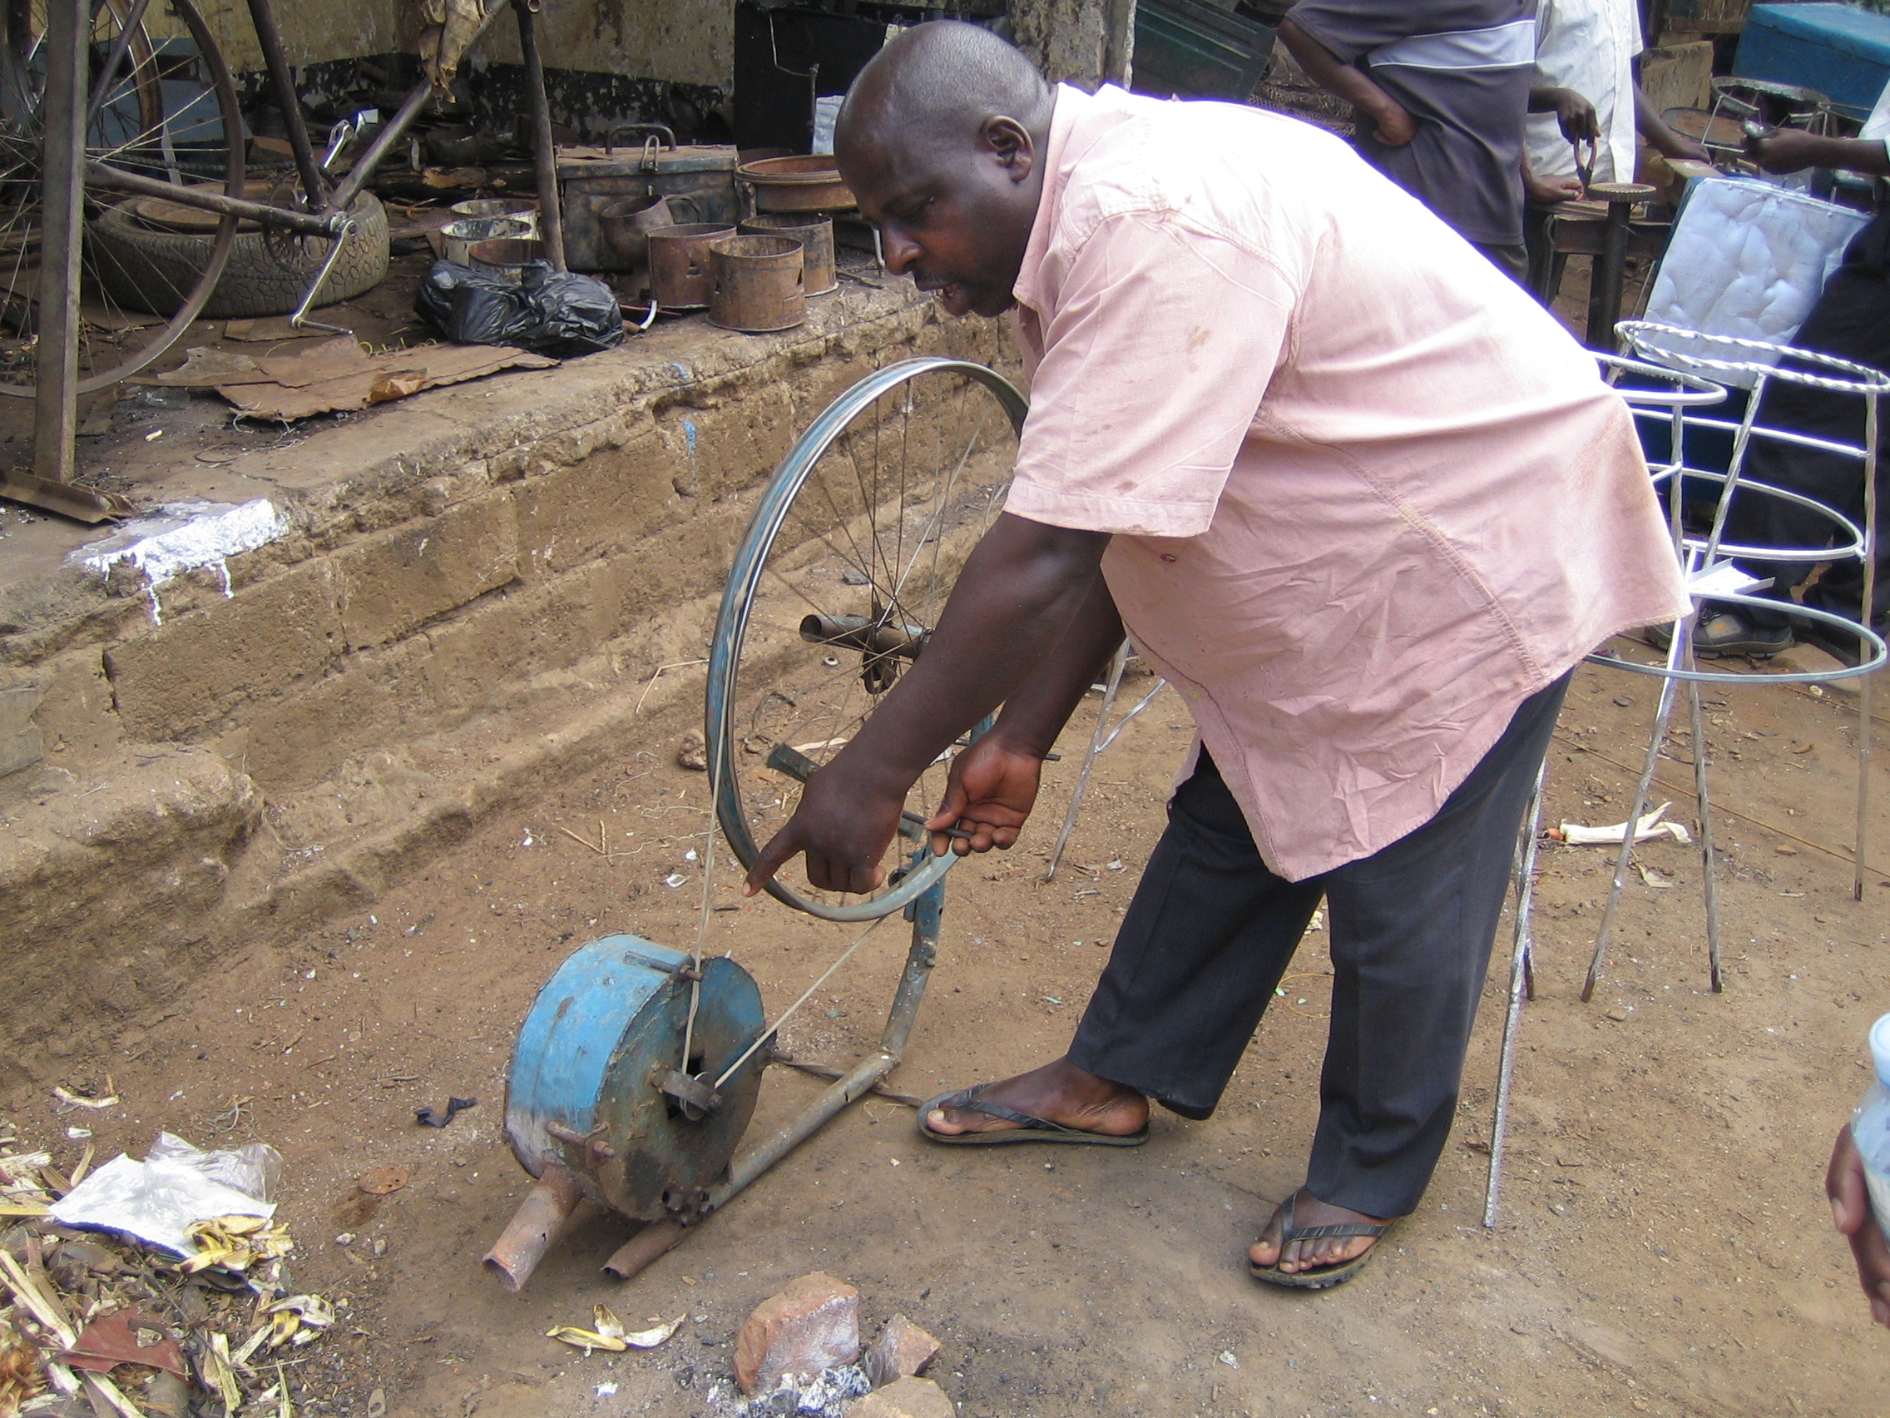
Critique of SCOT
Notes:
Another user appropriation
In Uganda, device for feeding oxygen to a fire

Slide 20
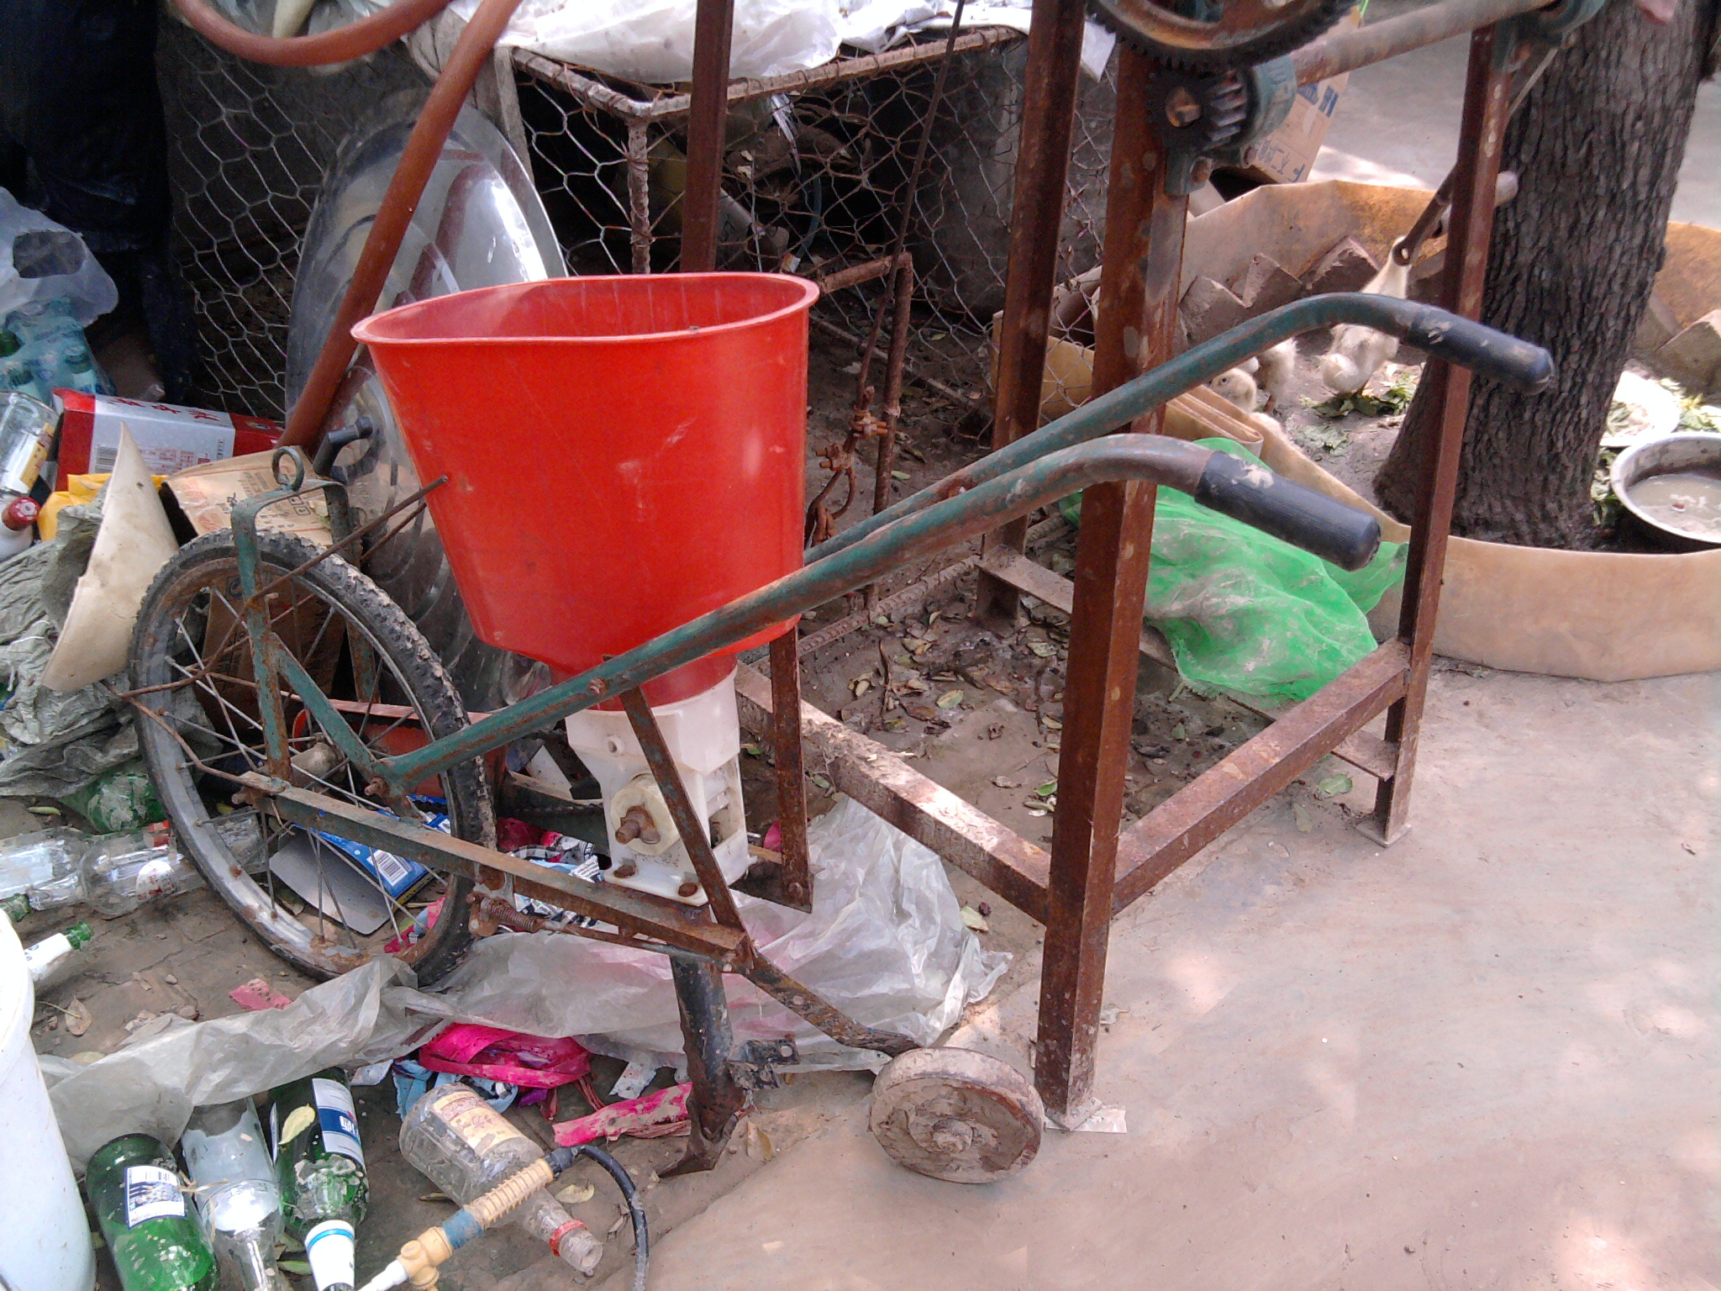
Notes:
China

Slide 21
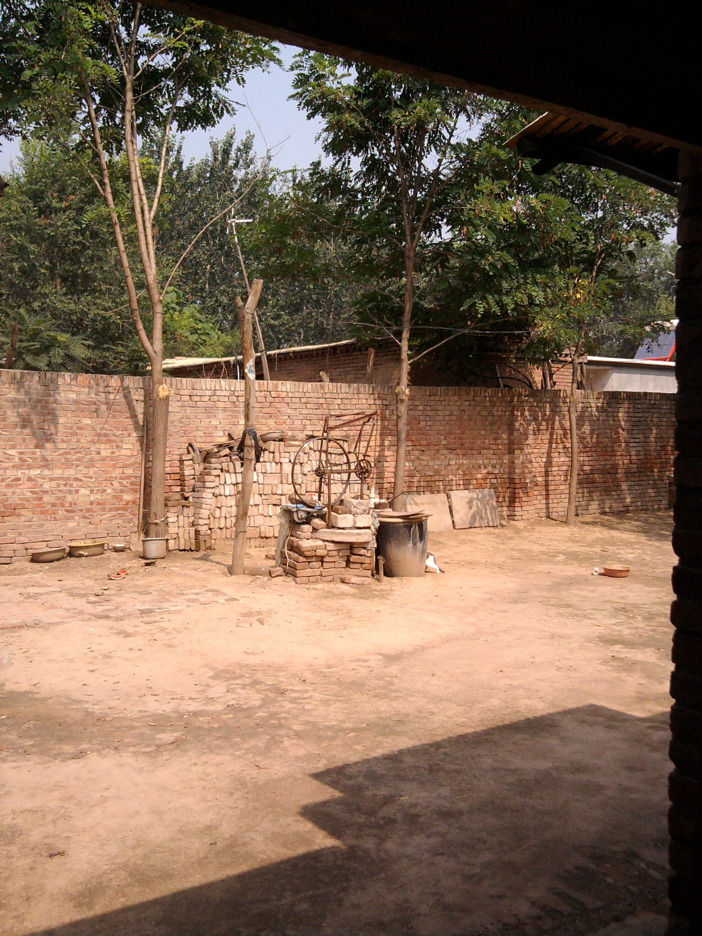
Notes:
China

Slide 22
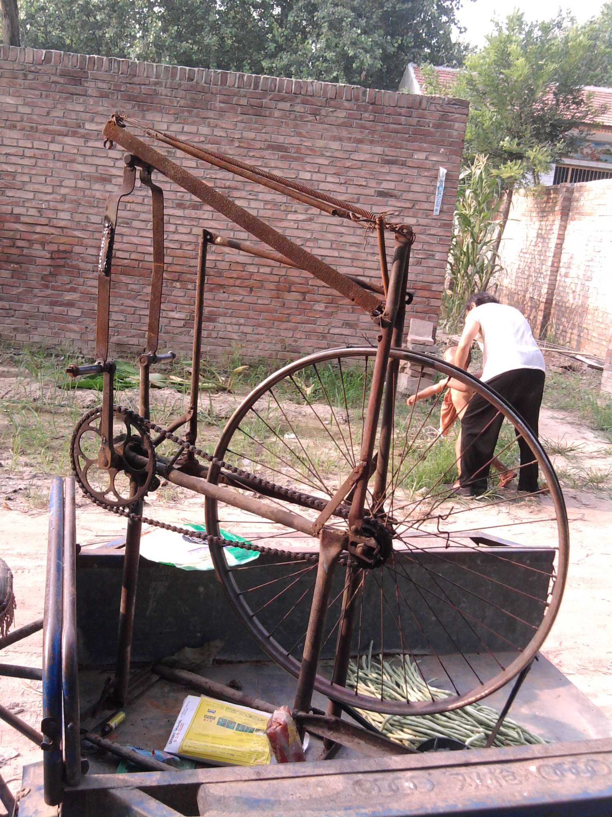
Notes:
China

Slide 23
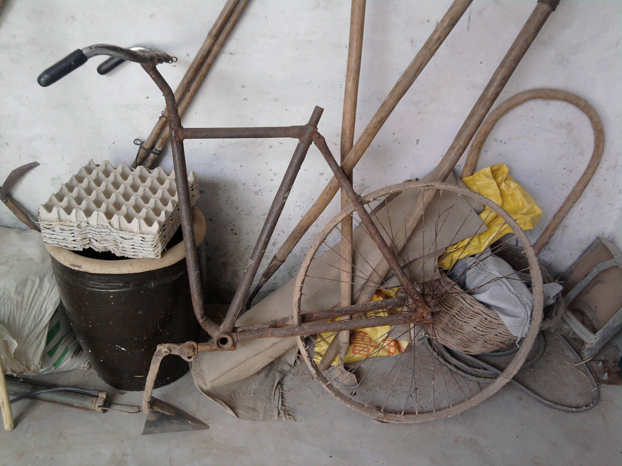
Notes:
China

Slide 24
Other Critiques of SCOT
Assumes equality of groups (every relevant social group treated as having the same influence, the same vote, no attention to power dynamics within or between groups)
“Politically Insipid” - SCOT tends to avoid making, “over-arching pronouncements for or against the particular technological developments…because [the researchers] know enough to realize the complexities they are examining that the futility of trying to change the world by pronouncements.”
Over-emphasizes agency, under-emphasizes structure
Notes:
Other critiques (not covered in class)

Slide 25
Administrative
Actor-Network Theory readings for Thursday…be patient with these readings, try to embrace the ambiguity, read for the big picture, why is Latour’s article titled “where are the missing masses?”

