Slide 1
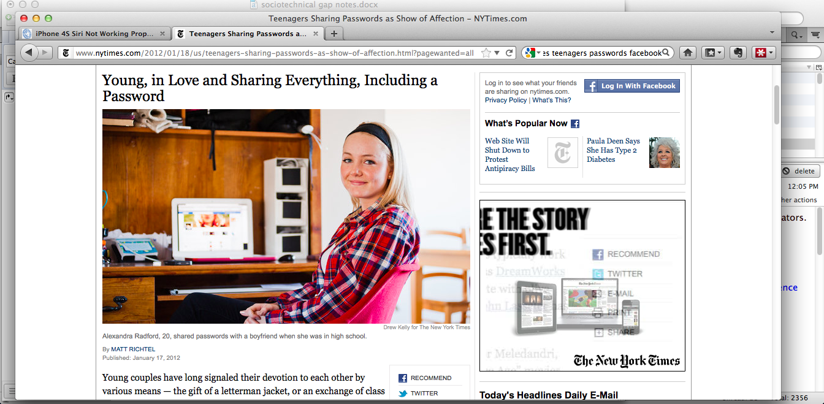

Slide 2
Session 2
The Social Life of Information, The Sociotechnical Gap, Do Artifacts Have Politics?
Notes:
Summary – all is not well in the information age. The three readings lay out the kinds of problems we’ll be exploring in this class. Specifically some tensions in the relationship between humans and machines (problems at both the micro and macro level), OR, how we as humans get by in a world that has been quite altered by the spread of various “information technologies” … the new demands on our limited human capacities.
An optimistic vision of technology suggests that we (as humans) should be masters over it, technology ought to do only what humans design for it to do. New technologies do things better than people alone or using previously existing technologies could do (i.e. more efficiently, more accurately, more thoroughly, more cheaply).
How do we deal with the fact that the lived experience is a lot more messy. The way we interact with or through information systems is ‘awkward’ (Ackerman). Machines / built artifacts can enforce a kind of social order against our intentions (or sometimes in support of darker intentions) (Winner). Can yield unintended consequences (Brown and Duguid).

Slide 3
Readings / How to Read
Empirical
Academic Publications
Statistical analysis
Qualitative – ethnographic, interviews, case study
Non-empirical
Summative Evaluation (of a research field, perspective)
Present a Concept / Vision
Present a Design Solution
Argumentative Essay

Slide 4
Readings / How to Read
Skim - read headings and subheadings. What does the piece seem to be about? What are your expectations about the piece based on the headings?
Read the introduction and maybe also the conclusion. Can you categorize it?
Read the rest of the piece. While reading, highlight sentences that capture the thesis, key arguments of the piece. Annotate in the margins: questions raised, connections to other readings or to ideas, to things happening in the world.
Digest – talk to someone else in class about the reading. Explain the main argument. Try to put it in your own words. Compare and contrast with another reading.

Slide 5
Task 1) categorize the readings, pick one reading and explain the argument to the rest of your group in your own words

Slide 6
Task 2) identify some examples of the sociotechnical gap
Has the use of a digital technology ever lead you to commit a social gaffe? Created some trouble in your social relationships (personal or professional)?
What is Ackerman’s general explanation for what is going on here?
What is the more specific explanation in the example you identify?
Could this be avoided through a design change?
Notes:
Some examples
Fired for Tweeting
Autocorrect
Skype chat messages pop up when you are giving a presentation
The phone that interrupted the New York Philharmonic - http://www.nytimes.com/2012/01/19/opinion/the-phone-that-interrupted-the-philharmonic.html

Slide 7
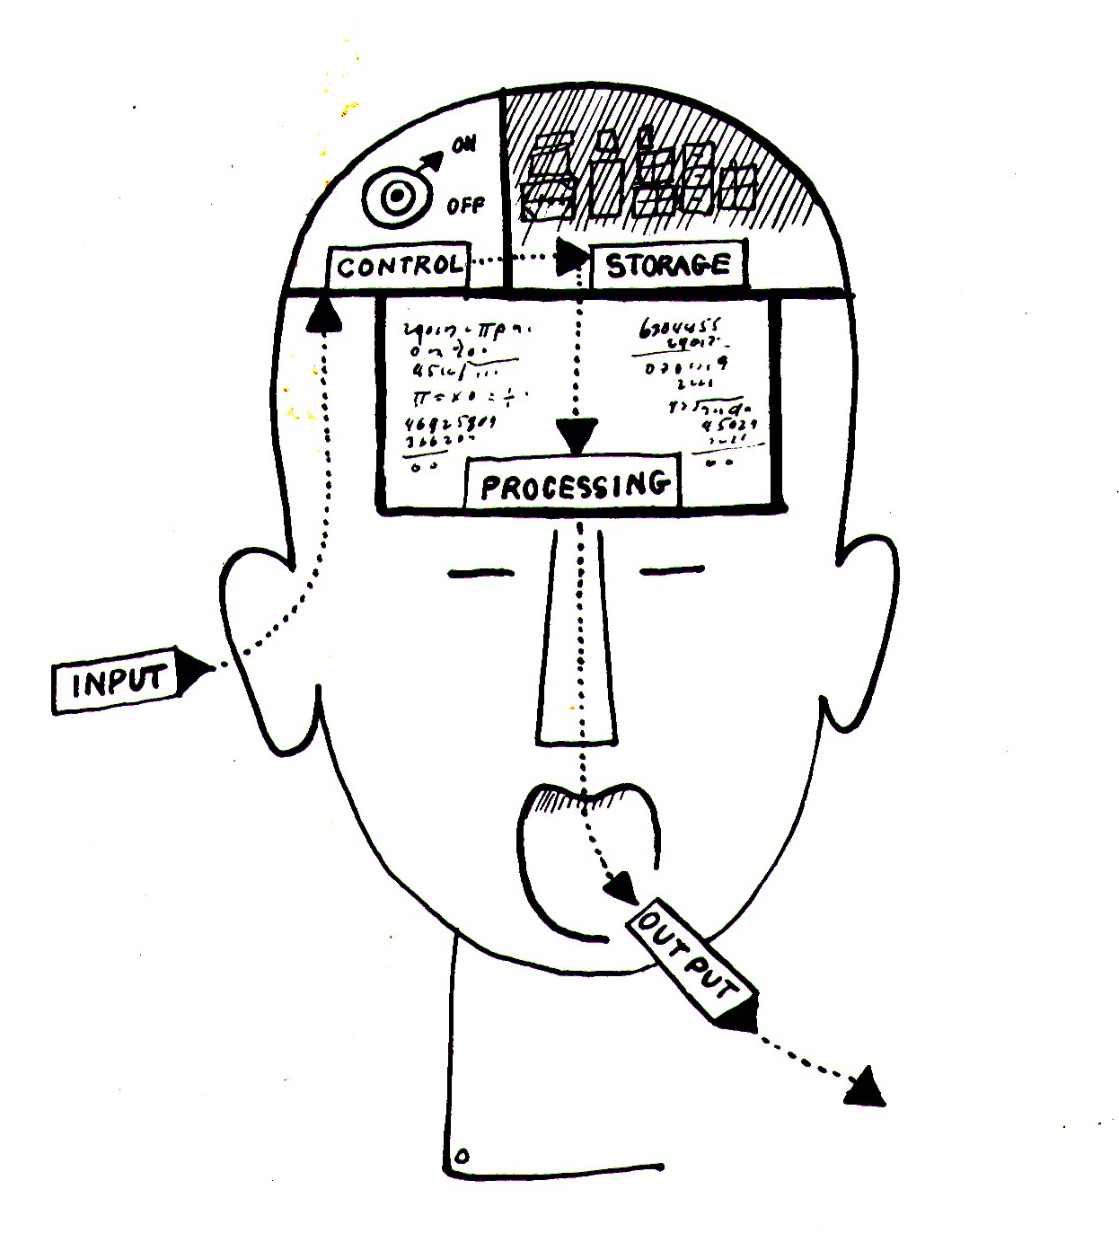
The Dream of the Machine that Could be Mistaken for Human
“I believe that in about fifty years' time it will be possible to programme computers, with a storage capacity of about 10⁹, to make them play the imitation game so well that an average interrogator will not have more than 70 percent chance of making the right identification after five minutes of questioning. … I believe that at the end of the century the use of words and general educated opinion will have altered so much that one will be able to speak of machines thinking without expecting to be contradicted.” – Alan Turing
Notes:
Alan Turing and “the Turing Test”
Didn’t get to this in class, but here it is for reference.
Underlining Ackerman’s point about how far AI is from perfectly solving this problem.
The difficulty in modeling human interactional practices very much underestimated early in the history of the field.

Slide 8
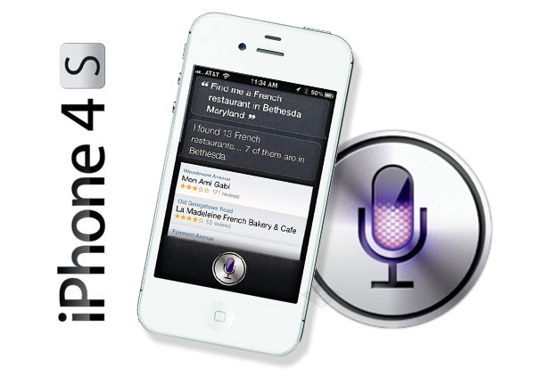
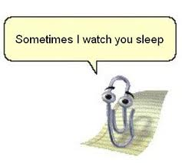
Anthropomorphism as a Design Feature
Notes:
What inspires this design choice?
What does the research say?
Is it always a bad idea? Why or why not?

Slide 9
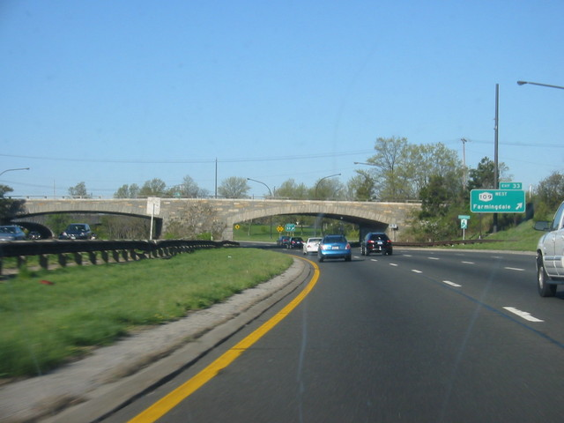
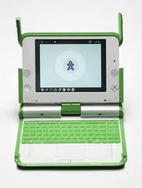
Can a bridge be discriminatory?
Notes:
is this what Winner meant when he talked about the overpasses of Long Island designed by Robert Moses?
“certain technologies in themselves have political properties seems…completely mistaken”
but if we argue that technology is made to matter by “the social and economic system in which it is embedded.” But doesn’t that suggest that technical things do not matter at all?
concerned with the effects of what is built and not necessarily with intentions.
brings in some very sociological questions of equality, injustice, inclusion, access (very sociological)
Gives examples where he argues there is intent (Moses’ overpasses) and where there is not intent (Americans with disabilities Act)
What is especially troubling about the bridge/overpass example? Social change and yet Moses’ design intentions are still there in the physical structure of the bridge. Minds may change, legislation too, but the bridges are still there – discriminating….”choices tend to become strongly fixed in material equipment…the original flexibility vanishes for all practical purposes once the initial commitments are made.” Also they can do so quite insidiously, invisibly.

